Slide 1







Weaponeering Principles
Major Jonathan Strawn
Director of Operations
21 Feb 2024
This Briefing is:
UNCLASSIFIED
Notes:
General idea here for template. Add your patch, title etc and feel free to change patches in upper right as needed.

Slide 2
This presentation UNCLASSIFIED
This briefing/presentation/document is for information only. No US Government commitment to sell, loan, lease, co-develop or co-produce defense articles or provide services is implied or intended
UNCLASSIFIED
Notes:
Squadron Structure and numbers, DSG and fulltime staff, unit location, dependency on or connection to outside agencies (Basic data & Demographics (Location, Unit Size, # AGRs, # DSGs, # Technicians, Rank Structure)
Think as well on how you fit into the larger DoD picture, who you get mission from (on the DoD side) and any unique deployment/employment constructs that exist. Consider including partner units across the country as well if you work closely with them.

Slide 3
References
Driels, Morris R. 2021., Weaponeering, Second Edition. (2013). American Institute of Aeronautics and Astronautics, Inc
Joint Publication 3-60, Joint Targeting, September 2018
Army Training Publication 3-21.8, Infantry Platoon and Squad, April 2016
Joint Publication 3-09.3, Close Air Support, April 2019
Army Training Publication 3-09.42, Fire Support for the Brigade Combat Team, March 2016
Army Training Circular 3-09.81, Field Artillery Manual Cannon Gunnery, April 2016

Slide 4
Weaponeering
Describe weaponeering and the principles that support the weaponeering process
Desired Learning Objectives:
Define weaponeering and understand its purposes
Understand the three pillars of weaponeering
Describe how weaponeering estimates support targeting
Explain the process for making weaponeering estimates

Slide 5
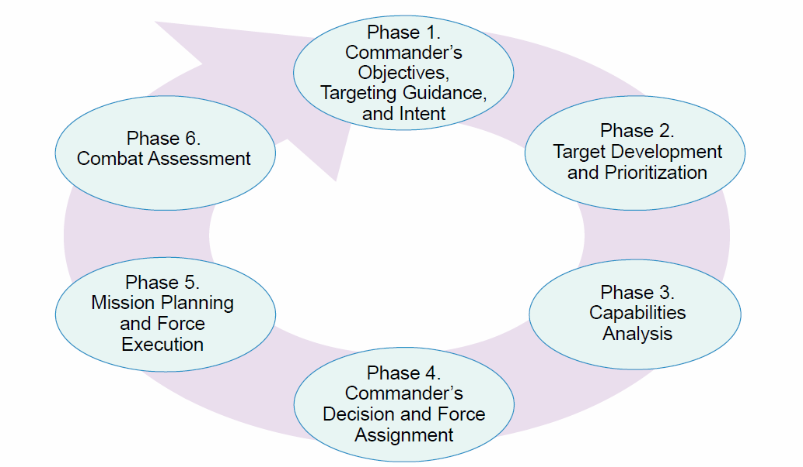
Joint Targeting Cycle

Slide 6
Weaponeering Definition
“The process of determining the quantity of a specific type of lethal or non-lethal means required to create a specific effect on a given target.”
JP 3-60, II-15
“…considering target vulnerability, weapon effects, munitions delivery error, damage criteria, probability of kill.”
Driels, 1

Slide 7
Weaponeering Purposes
Accomplish the mission
  Desired level of effect against a target to effect enemy warfighting
Economy of force
  Minimum level of force and optimum ordinance/capability
Mitigate risk
  Maximum damage to enemy with minimum danger to friendly forces
Options to deal with contingencies
  Weather / collateral concerns / contested-degraded operations/ camouflage, concealment, and deception / target mobility

Slide 8
Three Pillars
WEAPONEERING
VULNERABILITY
WEAPON
EFFECTS
ARRIVAL
CONDITIONS
Driels, 7-23

Slide 9
Aimpoint Definitions
Desired Mean Point of Impact (DMPI) Desired level of effect against a target to effect enemy warfighting
  A point designated as the center for impact of multiple weapons or area munitions to create a desired effect on a mobile, transportable, or area target and normally defined by grid reference or geolocation.
Desired Point of Impact (DPI)
  A precise point, associated with a target and assigned as the impact point for a single unitary weapon to create a desired effect.
Joint Desired Point of Impact (JDPI)
  A unique alpha-numeric coded precise aimpoint associated with a target to achieve an explicit weaponeering objective, and identified by a three dimensional (latitude, longitude, elevation) mensurated coordinate.
  JP 3-60 Definitions

Slide 10
Delivery Accuracy
Quantitative measurement of the capability of a weapon system to place ordnance on an intended target. Includes aiming errors, release conditions, aircraft system, ballistic dispersion
Unguided munitions
  Inherent precision error (round-to-round)
  Delivery platform dependent
Guided munitions
  Inherent guidance & control error (round-to-round)
  Platform independent
  Driels, 127-133

Slide 11
Delivery Accuracy Measurement
Two planes of measurement
  Ground (weapon impacts ground) – ie. Bombs, artillery
  Normal (directional impact) – ie. Direct-fire weapons, penetrators, missiles
Two units of measurement
  Milliradians (mils)
  Feet / meters
Two methods of measurement
  Circular Error Probable (CEP)
  Range Error Probable (REP) / Deflection Error Probable (DEP)
  Given with measure of precision and/or plane of reference
    Ie. (CEP₅₀) - Circular Error Probable – 50
    Ie. (CEP_{N}) - Circular Error Probable – Normal Plane
  Driels, 22, 136-137

Slide 12
Two Planes of Measurement
Ground plane
  Plane the target rests upon
  Parallel to level ground
  “top down” view
Normal plane
  Plane passing through the center of the target
  Perpendicular to the line-of-sight from the weapon-release point

Slide 13
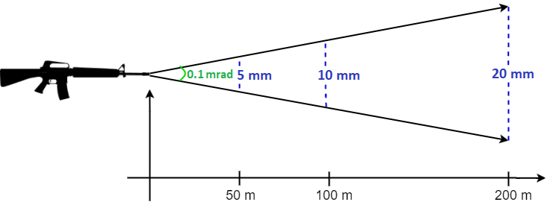
Two Units of Measurement
Milliradian (mil) (angular unit)
  Express accuracy independent of slant range
  Applies to the normal plane
  Feet / meters (distance unit)
Mil / distance relationship
  1 mil = 0.057 degrees or 1/6400 of a circle
    1 mil = 1 m at 1000 m slant range
1 m
Sauer202, CC BY-SA 4.0 via Wikimedia Commons
1000 m

Slide 14
Mil / Distance Example
Slant range (SR) = 1000 m
A 5 mil CEP at 2,000 m slant range = 2m (normal plane)
Slant range (SR) = 2000 m
5 mils CEP_{N}
Radius = 5 m
Radius = 10 m
SR = 3000 m
Radius = 15 m

Slide 15
Mil / Distance Example
Slant range (SR) = 1000 m
A 5 mil CEP at 2,000 m slant range = 2m (normal plane)
Slant range (SR) = 2000 m
5 mils CEP_{N}
Radius = 5 m
Radius = 10 m
SR = 3000 m
Radius = 15 m

Slide 16
Two Methods of Measurement
Measured as a % of weapons impact within a given distance from aimpoint
If 50% of weapons land within 6 m of aimpoint, then CEP₅₀ = 6 m
Described in either the normal or ground plane
weapon flight path
Circular Error Probable (CEP)
DPI
r = 6 m
CEP₅₀ = 6 m
  Driels, 22

Slide 17
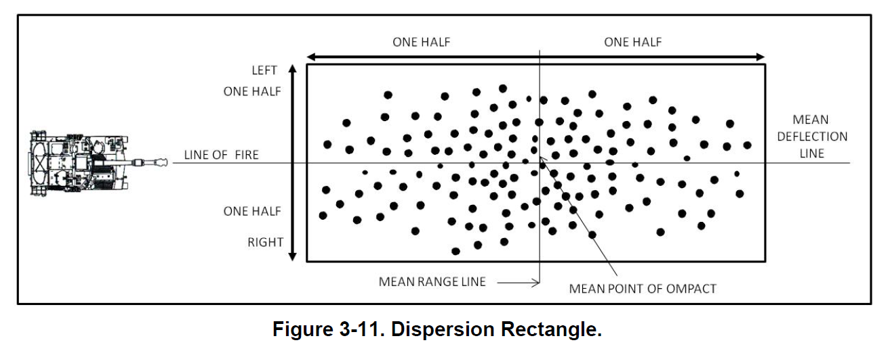
Two Methods of Measurement
REP₅₀
DEP₅₀
  Army Training Circular 3-09.81, 3-16

Slide 18
Delivery Accuracy Conclusions
For air-to-surface weapons, delivery accuracy is typically referred to in terms of CEP in the ground plane
CEP / REP/DEP only account for 50% of munitions
  REMEMBER – CEP₅₀ of 6 m means that 50% of weapons will impact GREATER than 6m from the aimpoint!
  Assumes no gross errors in aimpoint / release parameters
DPI

Slide 19
Three Pillars
WEAPONEERING
VULNERABILITY
WEAPON
EFFECTS
ARRIVAL
CONDITIONS
Driels, 7-23

Slide 20
Target Location Error
  JP 3-09.3, Close Air Support, III-32
TLE
  Actual target location vs. assessed target location
  Usually expressed as TLE90 – rarely as TLE50
    i.e., 90%(or 50%) of the time, the derived coordinates fall within X distance from the actual target location
Circular Error (CE)
Actual Target
Actual Target
Actual Target
Vertical Error (VE)

Slide 21
Target Location Error
TLE determined by the means a coordinate was derived
Charts, sensors, and methods have limits
Example: National Map Accuracy Standard 1:50000 chart
  90% of features must have error of less than 42 m
TLE only need to be of sufficient fidelity to create the desired effects on target through efficient battle tracking and effective fire support integration.
  JP 3-09.3, Close Air Support, III-31, Map Accuracy Standards | U.S. Geological Survey (usgs.gov)

Slide 22
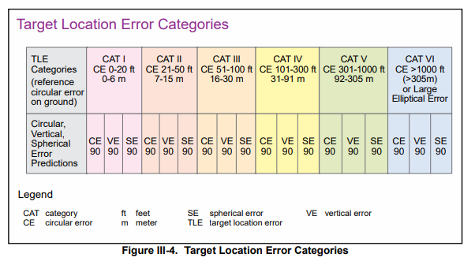
Target Location Error

Slide 23
Impact Parameters
Conditions of the weapon at impact effect the weaponeering solution
  Impact angle
    Higher usually better for velocity, penetration, and accuracy
    Some targets require low angle attack due to structural characteristic (ie. tunnels)
    Some weapons may give different effects at different angles (ie. Fragment patterns of air burst weapons)
  Impact velocity
    Too fast will exceed structural limits – weapon may break apart before effective detonation
    Too slow will not meet penetration requirements – weapon may not reach targeted area
  Quantity / spacing
    Multiple impact may be required to achieve desired results
    Damage from initial weapon may effect subsequent weapon results
Low angle
High angle
  Driels, 23

Slide 24


Quantity/Spacing
Initial Target Conditions
Post-Strike Target Conditions

Slide 25
Three Pillars
WEAPONEERING
WEAPON EFFECTS
VULNERABILITY
ARRIVAL CONDITIONS
Driels, 7-23

Slide 26
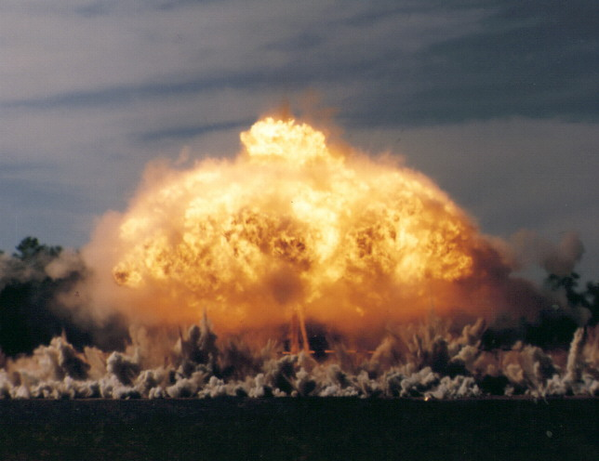
Damage Mechanisms
Munitions are designed to produce specific effects against different types of targets
Weapon construction, guidance, and fuzing all factor into overall munition effectiveness
Damage mechanisms
  Blast
  Fragmentation
  Shaped charge penetration
  Cratering
  Incendiary
Driels, 8-18v
Notes:
Photo: Wilcox, J. (n.d.). 40th Air Armament Symposium. In Arming 5th& 6th Gen Aircraft In An A2AD Environment. Fort Walton Beach; AFRL. Retrieved from https://www.ndiagulfcoast.com/events/archive/40th_symposium.htm.

Slide 27
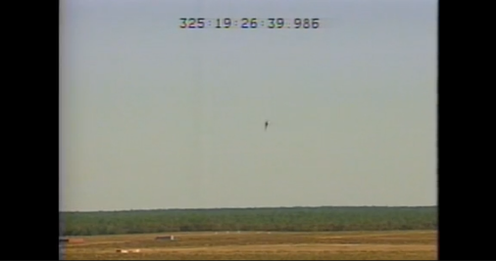
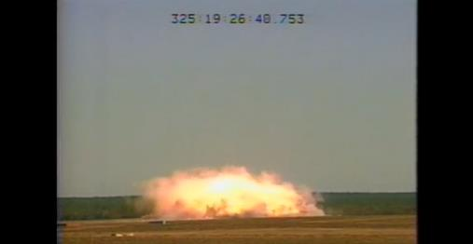
Damage Mechanism - Blast
High Explosive is converted to gas a high pressure and temperature
Sharply defined wave of increased pressure rapidly propagated through a surrounding medium
  High overpressure and dynamic pressure
  “Loading” – shock and quasi-static pressure
Blast effects dissipate quickly at a relatively predictable rate
Uniform distribution in all directions
  Independent of impact angle / velocity
Driels, 9-10
Notes:
https://www.dvidshub.net/video/519122/gbu-43-b-moab-2003-test-b-roll-color

Slide 28
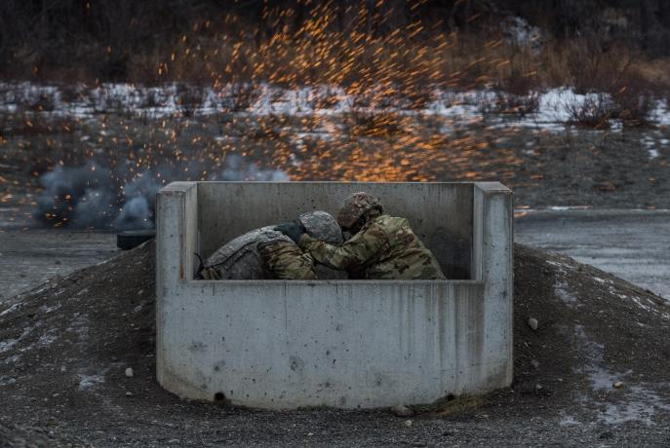
Damage Mechanisms - Frag
High velocity pieces from exploding warhead
Approximately 30% of explosive energy used to fragment casing
Fragments perforate target
  Casing can be scored to ensure predictable
  distribution of fragments
  Fragments travel faster & further than blast
  Density and velocity of fragments rapidly
  decreases over a given distance
  Fragmentation pattern depends on
    Explosive charge
    Height of burst
    Impact angle
Driels, 11-12
Notes:
https://www.dvidshub.net/image/4031122/3-geronimo-paratroopers-throw-live-grenades-jber

Slide 29
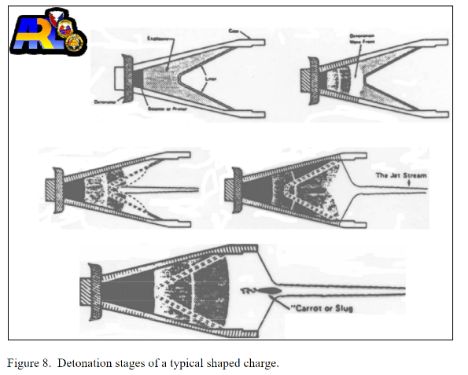
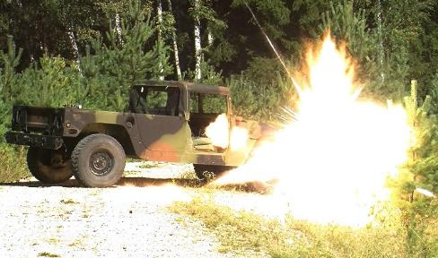
Damage Mechanism - Shaped Charged Penetration
Explosive charge with a shaped cavity
Concentrates explosive force in a single direction
  Explosive formed around a cone-shaped liner made of a material such as copper or aluminum.
  High velocity jet is formed by the detonating explosive
  collapsing, melting, and focusing the liner. The jet is
  capable of penetrating armor and concrete.
Warhead must hit the target
Notes:
https://www.dvidshub.net/image/2819567/2cr-res-trains-with-selectable-lightweight-attack-munition
https://www.dtic.mil/document;accessionNumber=ADA469696;type=TR;searchText=shaped%20charge%20walters;relatedTerms=undefined

Slide 30
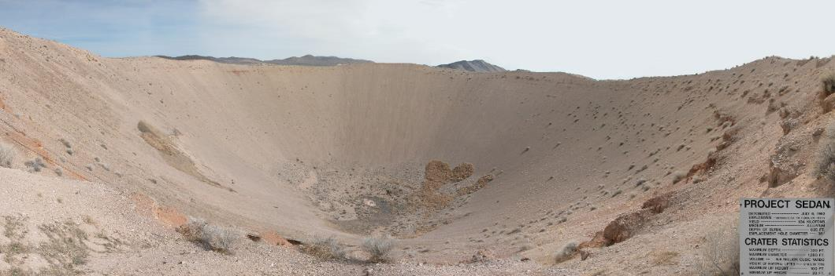
Damage Mechanism - Cratering
Manifestation of blast underground
Three damage mechanisms combined – Air Blast, Soil movement, concrete movement
Fuze settings / impact parameters effect the size of the crater
Sedan Crater, 194 m subsurface detonation, 98 m crater depth
Driels 944, Jarek Tuszyński / CC-BY-SA-4.0, CC BY-SA 4.0 via Wikimedia Commons

Slide 31
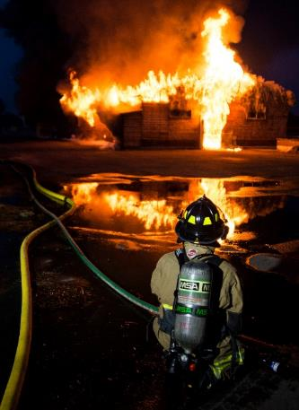
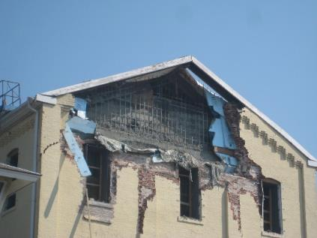
Secondary Damage Mechanisms
Weaponeering cannot account for post-strike effects
  Fire - Ignition of flammable materials
  Secondary blast/frag – storage of explosives in target area
  Structural collapse – compromise of structure from blast damage
  Flooding – plumbing or liquid storage in target area
  Toxic release – burning or release of stored materials
Notes:
https://www.dvidshub.net/image/3470746/let-burn

Slide 32
Three Pillars
WEAPONEERING
WEAPON EFFECTS
VULNERABILITY
ARRIVAL CONDITIONS
Driels, 7-23

Slide 33
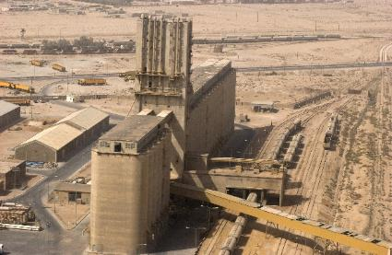
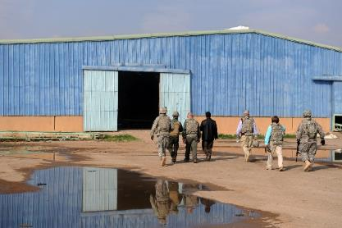

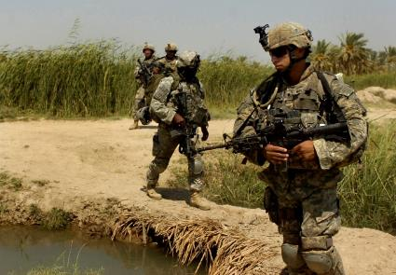

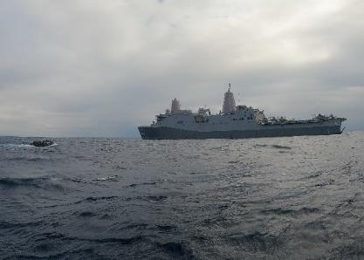
Blast Sensitive Targets
Buildings, bridges, personnel, ships
Driels, 9-10,533
Notes:
https://www.dvidshub.net/image/231759/grain-silo-visit
https://www.dvidshub.net/image/119613/iraqi-port-aerial
https://www.dvidshub.net/image/7052671/boat-operations
https://www.dvidshub.net/image/7970347/bridge-inspection
https://www.dvidshub.net/image/141776/taste-civilization
https://www.dvidshub.net/image/4390623/norad-and-usnorthcom-headquarters-building
https://www.dvidshub.net/image/54239/troops-choppers-attack-and-patrol-qubah

Slide 34
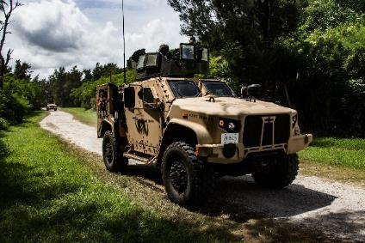
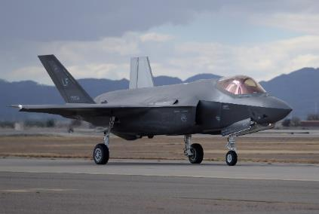
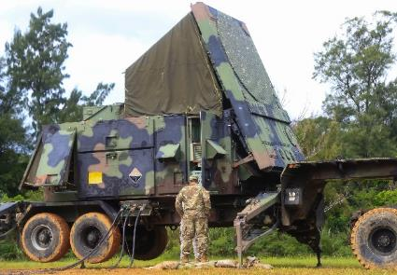
Frag Sensitive Targets
Light armor, aircraft, radars, people
Driels, 14
Notes:
https://www.dvidshub.net/image/6294115/brilliance-basics-marines-with-blt-2-4-31st-meu-participate-platoon-internal-training
https://www.dvidshub.net/image/2508478/f-35
https://www.dvidshub.net/image/3877653/patriot-radar
https://www.dvidshub.net/image/54239/troops-choppers-attack-and-patrol-qubah

Slide 35
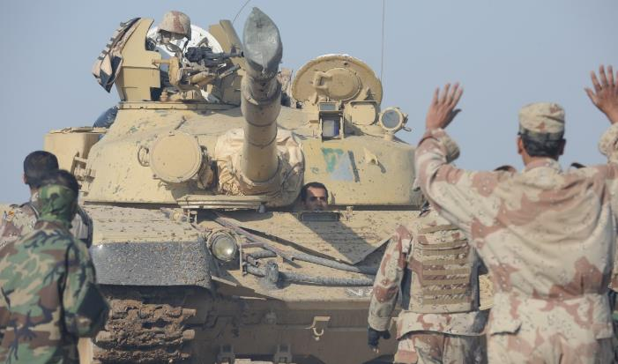

Shaped Charge Sensitive Targets
Armored & unarmored vehicles
Driels, 18
Notes:
https://www.dvidshub.net/image/125447/iraqi-tankers

Slide 36
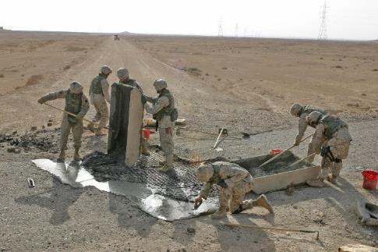
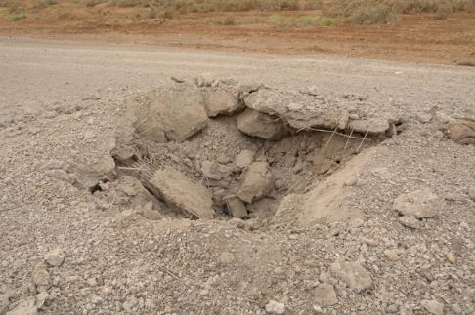
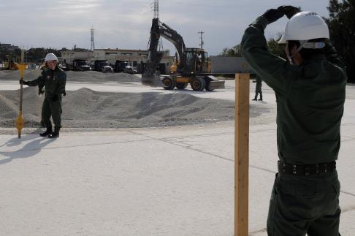
Cratering Sensitive Targets
Linear targets such as roads, taxiways, airfields
Cratering is disruption of soil & concrete – easily repaired
Notes:
https://www.dvidshub.net/image/60924/baqubah-focused-clearance
https://www.dvidshub.net/image/5986/marines-repair-crater-western-iraqi-road-recently
https://www.dvidshub.net/image/542752/runway-repair-raises-bilateral-relations

Slide 37
Damage Criteria
Damage Criteria is the critical level of weapon effects required to create specified levels of damage
Quantifies what specific damage (extent and type) is desired against a specific target
Aimed at achieving a desired effect, can be time-based
Three examples
  Mobility Kill (M-Kill) – vehicle cannot move, but can operate weapons
  Firepower Kill (F-Kill) – vehicle may move, but weapons are disabled
  Catastrophic Kill (K-Kill) – destroyed
JP 3-60 GL-5, ATP 3-21.8, G-25
Notes:
https://www.dvidshub.net/image/7291673/abrams-tracks-replacement

Slide 38
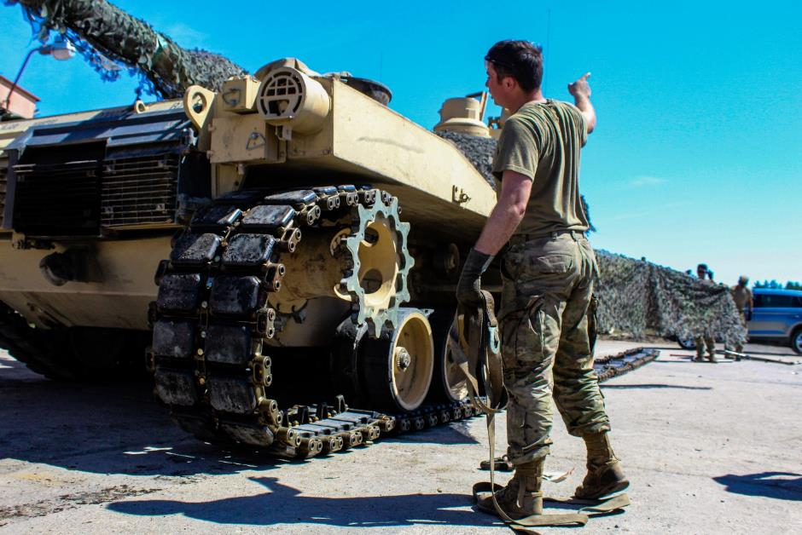
Mobility Kill (M-Kill)
Mobility Kill (M-Kill)
  May be possible to repair on site
  Weapon(s) may be functional
Notes:
https://www.dvidshub.net/image/7291673/abrams-tracks-replacement
38

Slide 39
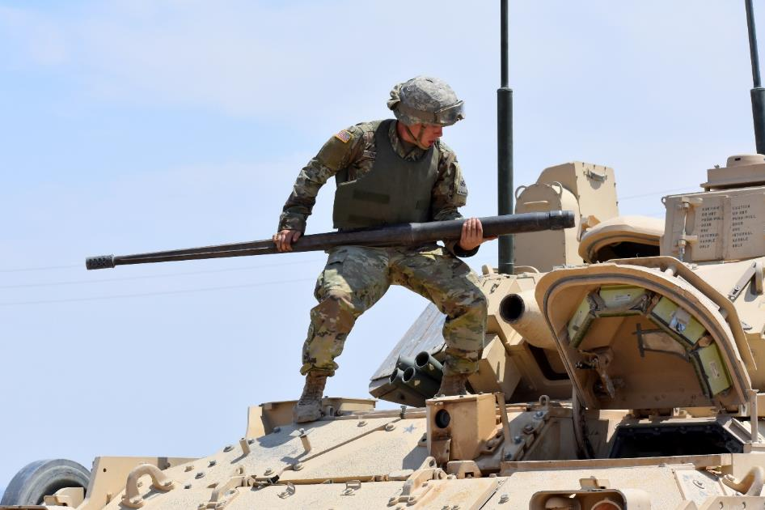
Damage Criteria (cont.)
Firepower Kill (F-Kill)
  Primary weapon(s) inoperable
  Equipment may or may not be mobile
Notes:
https://www.dvidshub.net/image/4634089/bradley-gunnery-bulldog-brigade-always-ready
39

Slide 40
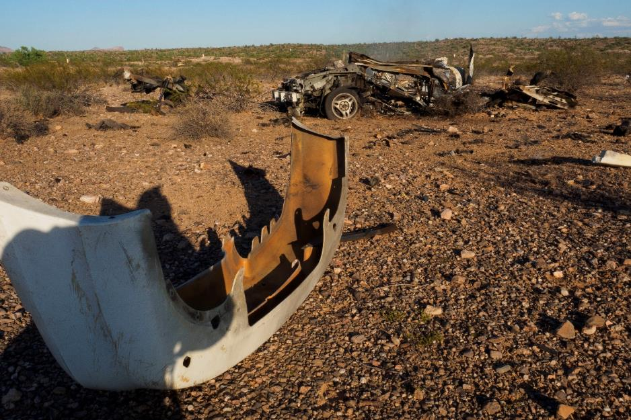
Catastrophic Kill (K-Kill)
Catastrophic Kill (K-Kill)
  Cannot be repaired
  Building uninhabitable
  Critical components unusable
Notes:
https://www.dvidshub.net/image/3702962/searching-answers-wreckage
40

Slide 41

Weaponeering Probability
Weaponeering results will always be displayed as a probability
Target types may be expressed differently
Unitary targets – single target consisting of a single
element – ie. Equipment
  PD (probability of damage) for a Unitary Target is
  a function of the delivery accuracy of the weapon and
  the damage mechanism of the weapon against the
  selected target type.
Area targets – defined by critical components within given area
  FD (fractional damage) for an Area Target:
  Percentage of target elements damaged to a specified desired level within a defined area.
Driels, 413, 475
Notes:
https://www.dvidshub.net/image/4614855/sac-children-hit-bullseye-tourney

Slide 42
Weaponeering
Describe weaponeering and the principles that support the weaponeering process
Desired Learning Objectives:
Define weaponeering and understand its purposes
Understand the three pillars of weaponeering
Describe how weaponeering estimates support targeting
Explain the process for making weaponeering estimates

Slide 43
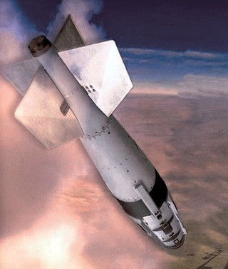
Questions
Major Jonathan Strawn
Jonathan.strawn@us.af.mil
DSN: 370-2340
Commercial: 253-984-2340
UNCLASSIFIED
Notes:
Example only. Place your own patch and contact info.

Slide 44

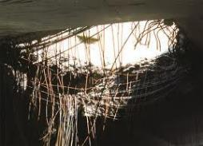
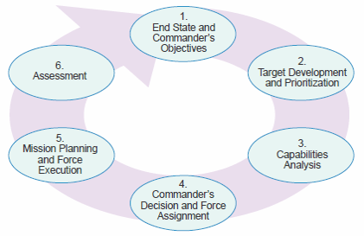
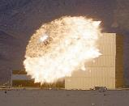

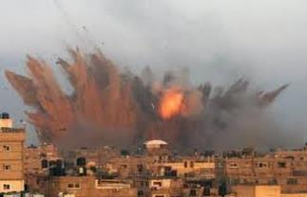
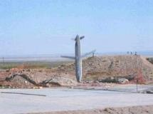
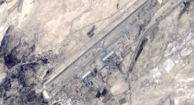
194 IS: Targeting Capabilities
Tailored Analysis to support Federated Partners
Target Systems Analysis
Multi-Domain analysis
Kinetic & Non-Kinetic vulnerability assessment
Deterrence & Competition
Joint Targeting Cycle
Intermediate Target Development
In-depth, Fused Analysis Products
Facility Outline / Critical Element / Overview Graphics
Electronic Target Folders
Combat Assessment (CA)
Advanced Target Development
Weaponeering Solutions
Precise Point Mensuration (PPM)
JASSM Target Development
Collateral Damage Assessment (CDE)
Dynamic Targeting
F2T2EA

