Slide 1
(U) Unit Level Intelligence
Capt John “KILL” Kenney
COPE TIGER 2024
This Briefing is:
UNCLASSIFIED//REL TO USA, SGP, THA

Slide 2
(U) DISCLAIMER
(U//FOUO) “THIS INFORMATION IS FURNISHED UPON THE CONDITION THAT IT WILL NOT BE RELEASED TO ANOTHER NATION WITHOUT SPECIFIC AUTHORITY OF THE DEPARTMENT OF THE AIR FORCE OF THE UNITED STATES, THAT IT WILL BE USED FOR MILITARY PURPOSES ONLY, THAT INDIVIDUAL OR CORPORATE RIGHTS ORIGINATING IN THE INFORMATION, WHETHER PATENTED OR NOT, WILL BE RESTRICTED, THAT THE RECIPIENT WILL REPORT PROMPTLY TO THE UNITED STATES ANY KNOWN OR SUSPECTED COMPROMISE, AND THAT THE INFORMATION WILL BE PROVIDED SUBSTANTIALLY THE SAME DEGREE OF SECURITY AFFORDED IT BY THE DEPARTMENT OF DEFENSE OF THE UNITED STATES. ALSO, REGARDLESS OF ANY OTHER MARKING ON THE DOCUMENT, ITS SECURITY PROTECTION WILL NOT BE DOWNGRADED WITHOUT THE APPROVAL OF THE ORIGINATING UNITED STATES AGENCY.”

Slide 3
(U) Overview
(U) What is the CIN?
(U) What roles does a CIN operate?
(U) What are the critical linkages between CIN elements?
(U) What are the critical guidance documents?
  (U) DOC statements
  (U) PIRs
  (U) IRDs
    (U) Debriefing and Reporting
Notes:
(U) Review slide.

Slide 4
(U) Purpose
(U) The purpose of this lesson is to provide basics of how a wing operates in peace time and “goes to war”
(U) It is not meant as an end-all-be-all lesson for every potential organizational construct of Wings
Notes:
(U) Review slide.

Slide 5
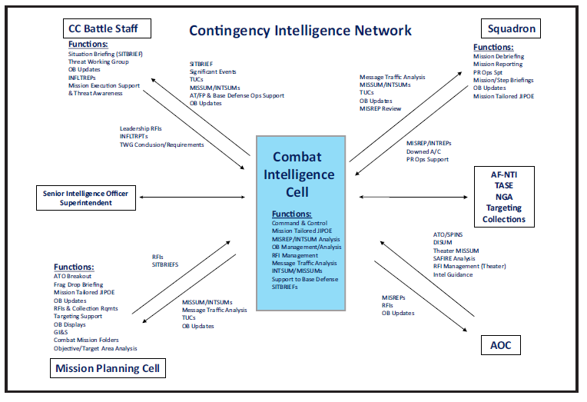
(U) Contingency Intelligence Network
UNCLASSIFIED//REL TO USA, SGP, THA
Notes:
(U) Review slide.

Slide 6
(U) Peacetime Unit-Level Organization
UNCLASSIFIED//REL TO USA, SGP, THA
Senior Intelligence Officer
Superintendent
“Analysis”
“Ops”
“Training”
“W&T”
“Targeting”
“Mission Planning”
Squadron Intelligence
Notes:
(U) Review slide.

Slide 7
(U) Peacetime Operations
(U) Largest focus of unit-level operations in peacetime is
on training
  (U) Internal and external (Intel training operators)
(U) Maintaining a current IPB against possible targets takes up bulk of analytic work
  (U) Many times misinterpreted as “Let’s make CIBs that sound cool”
(U) Peacetime operations should focus on ensuring the unit is ready for
contingency operations
  (U) Guidance: DOC statements, CONPLAN / OPLAN tasking
  (U) Resources: Manpower, systems, facilities, IPB resources *collection
  and production*
  (U) Training: Multiple levels of Intel training and
  contingency training
Notes:
(U) Review slide.

Slide 8
(U) Mission Analysis
(U) The same analytic framework we execute here is pivotal to unit operations
(U) Analyze your mission against the programmed capabilities (DOC ) and assigned tasks (plans)
  (U) Assigned tasking normally reflected in unit’s Designed Operational Capability (DOC) statement
    (U) Unit is programmed (manned / equipped) for a purpose
    (U) Statement which unit readiness is measured
    (U) Should include the types of missions unit is responsible
  (U) Tasked plans are normally OPLAN / CONPLAN
    (U) Assignment in tasked plan should match programmed capabilities in DOC statement
Notes:
(U) Review slide.

Slide 9
(U) Mission Analysis
(U) In order to execute expected missions, what is the adversary capability against our expected mission? → IPB *continuous process*
(U) Perform IPB/IPOE to determine knowns / unknowns about adversary
  (U) “Unknowns” are an intelligence gap
  (U) Develop specific details required to close intelligence gaps (EEIs)
(U) Follow-on of initial IPB is Prioritized Intelligence
Requirements (PIRs)
  (U) Outline information needs of to execute mission against the adversary
  (U) May be based on current Intel gaps, or information you cannot let become an intelligence gap
Notes:
(U) Review slide.

Slide 10
(U) Prioritized Intel Requirements
(U) PIRs should drive collection and production requirements to execute missions
  (U) Grey area on responsibility of who performs these functions
  (U) Normally nested within RFI Management process as part of contingency execution
(U) PIRs are WG/CC signed and the Intel shop’s way to reflect information needed to HHQ (operational level)
(U) Specifics are important …
  (U) What information do you need? When? Delivered where? In what format?
  (U) Ex: “require all-source OB updated every 12 hrs provided in KML file formats”
Notes:
(U) Review slide.

Slide 11
(U) Wartime Unit-Level Organization
UNCLASSIFIED//REL TO USA, SGP, THA
Senior Intelligence Officer
Superintendent
“Analysis”
“Ops”
“Training”
“W&T”
“Targeting”
“Mission Planning”
Squadron Intelligence
Squadron Intel
CIC
Command Post
Mission Planning Cell
Notes:
(U) Review slide.

Slide 12
(U) Combat Intelligence Network
(U) CIN is the contingency / wartime construct that unit-level intelligence organizes itself to “go to war”
(U) Specific structure and manning for a CIN is related to the mission and available manning to Wing Intelligence
(U) Multiple contingency responsibilities exist depending on your unit and missions
  (U) Primary job to increase the survivability and effectiveness of your wing’s mission
Notes:
(U) Review slide.

Slide 13
(U) CIN Requirements
(U) Every mission that takes off has a few key elements from an intelligence perspective that must be accomplished
(U) Without any of these elements, we cannot ensure mission success
(U) Requirements
  (U) IPB of Mission Area
  (U) IPB of Local Area
  (U) Targeting
  (U) Mission Products
  (U) Reporting
(U) Why?
  (U) Makes mission more survivable
  (U) Makes home survivable
  (U) Makes mission more lethal
  (U) Enables effective execution
  (U) Drives tomorrow’s missions
Notes:
(U) Review slide.

Slide 14
(U) Who Manages
Those Areas?
(U) Each section plays a hand in specific areas that the wing requires intelligence in order to launch effective combat sorties
(U) All of these elements together are known as the Combat Intel Network
Intel Prep of Mission Area | Intel Prep of Local Area | Targeting | Products | MISREPs
SQ/IN | CIC | MPC | MPC | SQ/IN
MPC | Battle Staff |  |  | CIC
CIC
Battle Staff
UNCLASSIFIED//REL TO USA, SGP, THA
Notes:
(U) Review slide.

Slide 15
(U) Combat Intel Network
UNCLASSIFIED//REL TO USA, SGP, THA
AOD
ACO/SPINS
ATO
Order of Battle
NRT Data - links
TUCs
CC Guidance
Local Threat
MPC
Combat Intel Cell
Battle Staff Intel
SQ/IN
Notes:
(U) Review slide.

Slide 16
(U) Combat Intel Network
UNCLASSIFIED//REL TO USA, SGP, THA
AOD
ACO/SPINS
ATO
Order of Battle
NRT Data - links
TUCs
CC Guidance
Local Threat
A3 Guidance
A2 Data
Prods
Sit Brief
MPC
Combat Intel Cell
Battle Staff Intel
IPB
Guidance
IPB
MISREP
Prods
SQ/IN
Notes:
(U) Review slide.

Slide 17
(U) Contingency Intelligence Network
UNCLASSIFIED//REL TO USA, SGP, THA
Notes:
(U) Review slide.

Slide 18
(U) MPC
(U) Where the mission begins …
  (U) Pulls guidance docs to lay out initial situation for planning
  (U) Includes operational career fields based on mission (pilots, WSO, space, etc)
  (U) MPC Chief at Wing level is normally one of the weapons officers (it could be you)
(U) Roles
  (U) Develops the plan for tactical-level execution and liaises with operational level
  (U) Intel provides battlespace preparation (IPB) and targeting
  (U) Produces mission materials for tactical execution
(U) Products
  (U) Mission Materials
  (U) RFIs
Relationships
Provides |  | Needs
What? | To? | What? | From?
Prods | SQ | IPB | CIC
IPB | MPC | Guidance | AOC
UNCLASSIFIED//REL TO USA, SGP, THA
Notes:
(U) Review slide.

Slide 19
(U) MPC
(U) Where the mission begins …
  (U) Pulls guidance docs to lay out initial situation for planning
  (U) Includes operational career fields based on mission (pilots, WSO, space, etc)
  (U) MPC Chief at Wing level is normally one of the weapons officers (it could be you)
(U) Roles
  (U) Develops the plan for tactical-level execution and liaises with operational level
  (U) Intel provides battlespace preparation (IPB) and targeting
  (U) Produces mission materials for tactical execution
(U) Products
  (U) Mission Materials
  (U) RFIs
MORE ON THIS IN IMPC/MISREP ACADEMICS
Relationships
Provides |  | Needs
What? | To? | What? | From?
Prods | SQ | IPB | CIC
IPB | MPC | Guidance | AOC
UNCLASSIFIED//REL TO USA, SGP, THA
Notes:
(U) Review slide.

Slide 20
(U) Combat Intel Cell
(U) Where the mission comes together …
  (U) Hub of Intel data-flow into AND out-of wing
  (U) Wartime Chief is normally the SIO
(U) Roles
  (U) Manages incoming information from higher echelon (OB, TUCs, etc)
  (U) Manages outbound requests from higher echelon (RFIs)
  (U) Provides common IPB baseline for all wing missions *CIP*
  (U) QCs products from SQ (MISREP / INTREP)
(U) Products
  (U) IPB
  (U) CIP
Relationships
Provides |  | Needs
What? | To? | What? | From?
IPB | All | Intel | External
Sit Brief | MPC/BS | MISREPs | SQ/IN
MISREP QC | AOC | RFIs | Everyone
CIP/OB | All | Prods | MPC
UNCLASSIFIED//REL TO USA, SGP, THA
Notes:
(U) Review slide.

Slide 21
(U) RFI Process
UNCLASSIFIED//REL TO USA, SGP, THA
Collection Requirement
Identified
Dissemination
Planning &
Direction
Feed Back
Analysis &
Production
Submit
Production
Requirement
Collection
Processing &
Exploitation
Submit
Collection
Requirement
Yes
No
No
Information
already
collected?
Yes
Local
production
possible?
No
Requirement
valid?
Yes
Yes
Product
Local
Production
Submit
RFI in COLISEUM
Close RFI
Yes
Requirements
satisfied?
No
Return RFI
Intelligence
Requirement
Notes:
(U) Review slide.

Slide 22
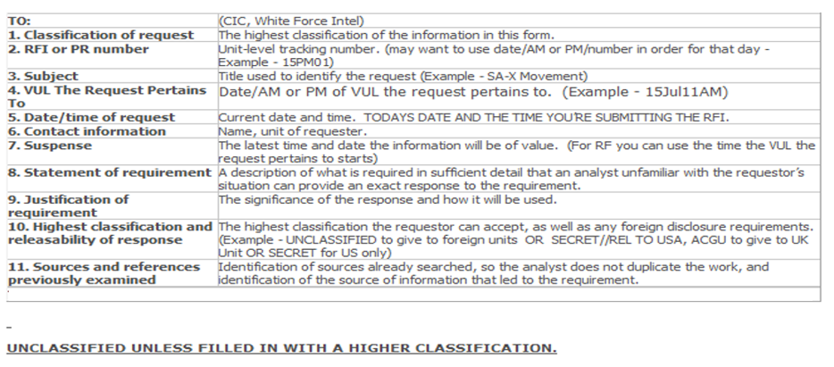
(U) Submitting an RFI
UNCLASSIFIED//REL TO USA, SGP, THA
UNCLASSIFIED//REL TO USA, SGP, THA

Slide 23
(U) RFI Rules to Remember
(U) BE SPECIFIC – most important part of an RFI
(U) Subject should clearly represent the req at the lowest possible classification
(U) State the overall purpose of the request and identify how the info will be used – always include a solid justification
(U) Specify what type of product you want in return – briefing/two line email/short answer
(U) Tie the RFI to the mission – state how it will support it
(U) Include ALL information needed to fully answer the RFI – do not abbreviate – lessen possibility of confusion
(U) Don’t assume analyst will know what you want reported
(U) Exhaust all sources prior to submitting an RFI – state what resources you reviewed
Notes:
Weaknesses of RF-A RFI Forum:
Scenario-ism, basically because this is a simulated real world scenario, the RFI format that participants fill in isn’t going to be what a real-world RFI format would be. Also, because AM/PM vuls are very similar, the participants tend to copy and paste RFI’s they sent for the AM shift, and ask an identical question for the PM shift. There have also been instances where participants will confuse the AM/PM vuls and use information gathered from AM and use them during the PM vul.
Even though this is simulated, the process of filling out particular portions of the RFI, and submitting them to a ‘geographically separated’ AOC to receive answers is good practice for what a real life situation would be. Participants are not allowed to come to the white force cell in person and ask any RFI’s. If There is a particular question that needs immediate attention, there is a VOIP that the CIC can call, answered by a member of the White Force Team and they will receive an answer within a short time frame, while RFI’s sometimes take up to an hour to be returned via the website.

Slide 24
(U) RFI Examples
(U) Bad: “Report on activity of enemy airfields”
(U) Good: “Report the following at Cedar Airfield in order of priority”
  (U) What are the conditions of the runway? Cratered? Evidence of repair?
  (U) Are enemy aircraft observed on the flight-line? What type of aircraft? What load-outs are present?
  (U) Are tanks or APCs present in the area? What is the typical ground order of battle for this facility? What is the typical security component?
  (U) Are there obstacles on the roads leading to the airfield? Are they permanent or temporary?
(U) Specific, no abbreviations
Notes:
APC: Armored personnel carrier

Slide 25
(U) Battle Staff Intelligence
(U) Intel’s eyes and ears in the battle staff
  (U) Keeps the boss informed … and the rest of us
(U) Roles
  (U) Provides actionable Intel to nonoperations base agencies (FP)
  (U) Briefs key events and impact to leadership
  (U) Relays data and guidance back to Intel flight
(U) Products
  (U) Guidance …
Relationships
Provides |  | Needs
What? | To? | What? | From?
RFIs | CIC | IPB | CIC
Sit Brief | CP | Mission | MPC
Sit Awareness | CIN
UNCLASSIFIED//REL TO USA, SGP, THA
Notes:
(U) Review slide.

Slide 26
(U) Squadrons
(U) The delivery method of the plan…
  (U) Final sanity check of data, instructions to aircrew, and first intelligence reporting of mission
(U) Roles
  (U) Monitors information flow into wing (KML, Sit Briefings)
  (U) Briefs aircrew mission and PR data (PMB)
  (U) Debriefs aircrew and drafts mission reporting (MISREP)
  (U) Manages missions specific info requirements for SQ (RFIs)
(U) Products
  (U) MISREP
  (U) RFIs
UNCLASSIFIED//REL TO USA, SGP, THA
Relationships
Provides |  | Needs
What? | To? | What? | From?
RFIs | CIC | IPOE | CIC
MISREP | CIC | Mission | MPC
Brief | Aircrew
Notes:
(U) Review slide.

Slide 27
(U) The MISREP
(U) Mission Reports (MISREPs) are AOC-mandated documentation of mission execution
  (U) Format and required content dictated by operational level
(U) MISREP is the only formal ops documentation of a mission
  (U) Some maintenance documentation exists
  (U) Flight recordings normally archived for very limited time
Notes:
(U) Review slide.

Slide 28
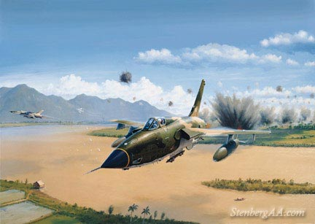
(U) Intelligence Debriefing:
Role and Importance
(U) Why debrief?
  (U) To ensure that all critical mission information is captured, analyzed and disseminated in a timely manner
  (U) What you capture can make a direct impact on
  combat operations
    (U) BDA
    (U) Enemy TTPs
    (U) Sightings
    (U) JSIRs
UNCLASSIFIED
Notes:
(U) Is another sortie necessary? Attack that target again? Possibly another DCA sortie?
(U) All the answers are determined/initiated by the debriefing.
(U) Sound debriefing can result in a reduced sortie requirement and one less aircrew put in harm’s way.

Slide 29
(U) Reporting
(U) Why write a MISREP?
  (U) Only written history of what happened
  (U) Track mission results
  (U) Analyze threat trend data
  (U) EWIR / MD updates / feedback
Notes:
(U) A good debriefing must evolve into a good report or no one, but the author, will understand the mission.
(U) HHQ often does not have recent squadron experience; therefore, sound reporting with minimal jargon is essential.
(U) Mission results are primary. Utilize parentheses to
explain acronyms.
(U) IWO:
(U) Responsible for quality.
(U) Responsible for building accurate picture/assessment.
(U) Fuse MISREP data with other MISREP/INT.
(U) RWR vs known ambiguities vs other sources.
(U) RWR: Loc, BRGT, symbol, duration, tone.
(U) Ambiguities: Troposcatter communications, jammers, other
radars *counterbattery*.

Slide 30
(U) Reporting
(U) Why write a MISREP?
  (U) Only written history of what happened
  (U) Track mission results
  (U) Analyze threat trend data
  (U) EWIR / MD updates / feedback
MORE ON THIS IN IMPC/MISREP ACADEMICS
Notes:
(U) A good debriefing must evolve into a good report or no one, but the author, will understand the mission.
(U) HHQ often does not have recent squadron experience; therefore, sound reporting with minimal jargon is essential.
(U) Mission results are primary. Utilize parentheses to
explain acronyms.
(U) IWO:
(U) Responsible for quality.
(U) Responsible for building accurate picture/assessment.
(U) Fuse MISREP data with other MISREP/INT.
(U) RWR vs known ambiguities vs other sources.
(U) RWR: Loc, BRGT, symbol, duration, tone.
(U) Ambiguities: Troposcatter communications, jammers, other
radars *counterbattery*.

Slide 31
  (U) Questions?
Notes:
(U) Review slide.

