Slide 1
UNCLASSIFIED//REL TO USA, SGP, THA
(U) Intel MPC and Debrief/MISREPs
Capt John “KILL” Kenney
COPE TIGER 2024
This Briefing is:
UNCLASSIFIED//REL TO USA, SGP, THA
FDO#: 2022-0304-240 PACAF/A2
Disclosed: 20220304 REL TO USA, SGP, THA
UNCLASSIFIED//REL TO USA, SGP, THA
Notes:
(U) Add IMPC academics, and then fix the MISREP template to match the one in the cope tiger docs

Slide 2
(U) DISCLAIMER
(U//FOUO) “THIS INFORMATION IS FURNISHED UPON THE CONDITION THAT IT WILL NOT BE RELEASED TO ANOTHER NATION WITHOUT SPECIFIC AUTHORITY OF THE DEPARTMENT OF THE AIR FORCE OF THE UNITED STATES, THAT IT WILL BE USED FOR MILITARY PURPOSES ONLY, THAT INDIVIDUAL OR CORPORATE RIGHTS ORIGINATING IN THE INFORMATION, WHETHER PATENTED OR NOT, WILL BE RESTRICTED, THAT THE RECIPIENT WILL REPORT PROMPTLY TO THE UNITED STATES ANY KNOWN OR SUSPECTED COMPROMISE, AND THAT THE INFORMATION WILL BE PROVIDED SUBSTANTIALLY THE SAME DEGREE OF SECURITY AFFORDED IT BY THE DEPARTMENT OF DEFENSE OF THE UNITED STATES. ALSO, REGARDLESS OF ANY OTHER MARKING ON THE DOCUMENT, ITS SECURITY PROTECTION WILL NOT BE DOWNGRADED WITHOUT THE APPROVAL OF THE ORIGINATING UNITED STATES AGENCY.”
FDO#: 2022-0304-240 PACAF/A2
Disclosed: 20220304 REL TO USA, SGP, THA

Slide 3
(U) MPC Methodology
(U) ME3C-(PC)²
  (U) Mission
  (U) Environment
  (U) Enemy
  (U) Effects
  (U) Capabilities
  (U) Phasing
  (U) Contracts
  (U) Plan
  (U) Contingencies
(U) Meetings
  (U) Design Initiation Meeting
  (U) Mission Analysis Meeting
  (U) Game Plan Development Meeting
  (U) Game Plan Analysis and Wargaming
  (U) Game Plan Comparison and Approval Meeting
Notes:
(U Mission- CC intent, Objectives, ALR
(U) Environment-POLMIL, Operational (theater guidance), Physical (wx, diverts etc), Geographic
(U) Enemy- Number, type, location, COAs

Slide 4
(U) IMPC Meetings, DIM/MAM
(U) DIM
  (U) Present the Tactical Problem, ATO tgts, threats, and adversary COAs
  (U) Audience: MPCC
  (U) Time: 5-10, but no more than 15 minutes
(U) MAM
  (U) Same same, but different
  (U) Present the Tactical Problem, ATO tgts, threats, and adversary COAs
  (U) Audience: Team Leads
  (U) Time: No more than 10 minutes
  (U) Start giving red a vote
Notes:
(U) The pilots are not

Slide 5
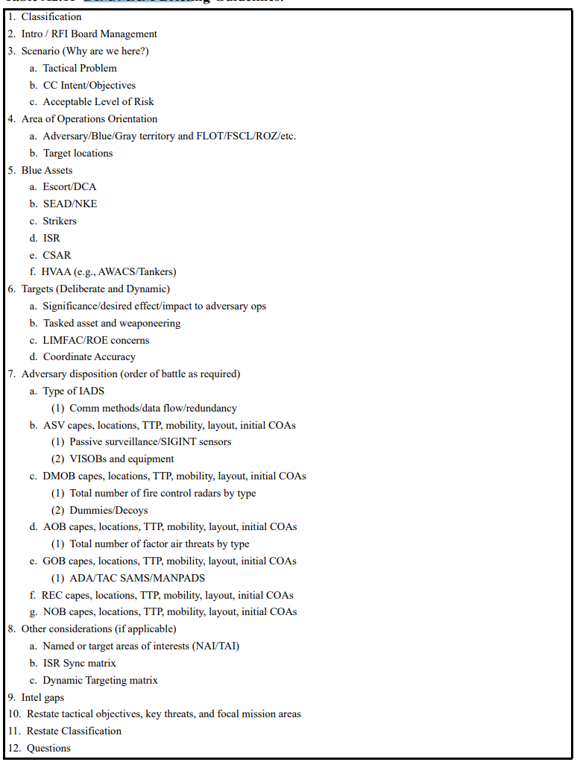
(U) AETTP 3-3.IPE Table A2.11

Slide 6
(U) IMPC Meetings, TL Meetings
(U) F2T Breakout
  (U) ISR TL communicates the F2T Gameplan
  (U) ITL provides assistance by fielding questions related to red (IF ISR TL cannot answer)
(U) TEA Breakout
  (U) C2 TL run, attend if able to answer questions for red
(U) Attend other briefings as MSN/CC requires, focus on giving red a voice in the blue gameplan
Notes:
(U) The pilots are not

Slide 7
(U) IMPC Mtgs, GPDM/GPAW/GCAM
(U) GPDM
  (U) Answer RFIs
  (U) Red Penning the Most Likely COA
(U) GPAW
  (U) Red Penning MDCOA and Contingencies
(U) GCAM/Mass Brief
  (U) 5-7 minutes on Msn, Environment, Enemy including #/Type/Location and COAs
Notes:
(U) The pilots are not

Slide 8
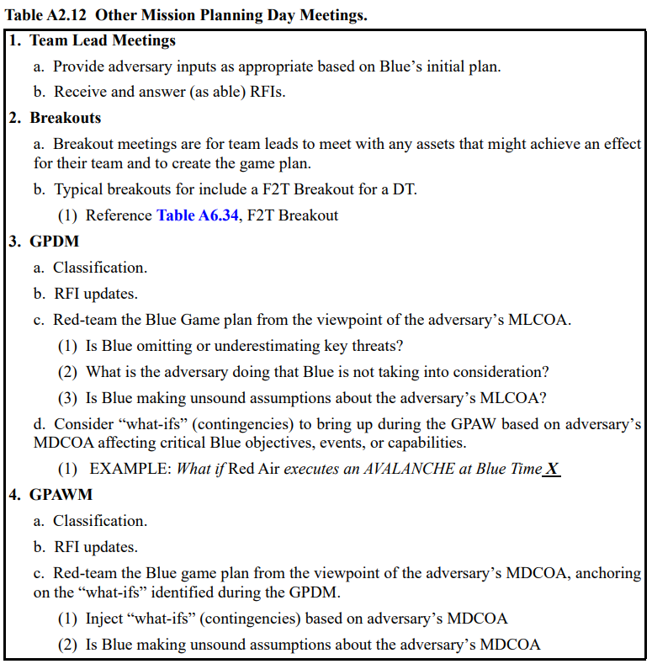

Slide 9
(U) Debriefing Overview
(U) A good debrief and well written MISREP can:
  (U) Influence an air campaign
  (U) Alter blue forces tactics
  (U) Trigger avionics software changes
(U) (U) Reporting on overall msn success
(U) ROE and LOAC Issues
  (U) Msn is properly documented
(U) Important individuals may read your MISREP
Notes:
(U) The pilots are not the only customers of the MISREPS.

Slide 10
(U) The Debriefing Process
(U) Requires:
  (U) Understanding of mission, ROE, tactics, brevity terms, symbology
  (U) Ability to obtain information from the tapes
(U) Begins with the Pre-mission Brief
  (U) EEIs
Notes:
(U) Watching the tapes will greatly help your Situational Awareness when debriefing. Although not possible during every exercise, it is a must for combat debriefs when not doing a quick turn. Some quick turns that involve bomb load-ups may give you enough time to extensively debrief and watch the videos.
(U) The tape is especially helpful for understanding air engagements, BDA, and visual sightings. Remember, that no matter who reviews the tapes, YOU are the Intel expert. Normally, during an exercise, a fighter pilot will review the tapes and grade them. However, during combat ops, they made not be able to spare any pilots. Therefore, they may merely have untrained Intel analysts watching the tapes. In addition, some theaters have the tape review merely for a Public Affairs function. In these cases, its necessary for you to review the film and declare a hit or miss.
(U) If there is a miss, you need to contact the ATO shop and Wing Intel immediately. Wing Intel should begin the refragging process.
(U) In order for you to understand the tapes, you need to understand all of the symbology. Knowledge of the entire spectrum of symbology will be necessary. This includes radar, HUD, the targeting pod, and the HTS pod symbology.

Slide 11
(U) EEIs
(U) Essential Elements of Information
  (U) Items which may have a significant impact on operators
  (U) Could impact later missions if information is gained/not relayed
(U) Who is responsible for defining EEIs?
  (U) AOC? Wing Intel? SQ Intel?
  (U) May vary by theater
  (U) Examples…
Notes:
(U) Layout of Threat of the Day (TOD) briefing.
(U) Vis Recce
(U) Countries of Employment
(U) Role and Mission
(U) Variants
(U) Combat Data:
(U) Maneuverability
(U) Fire Control Systems:
(U) AI Radar
(U) Fire Control Systems
(U) RWR,
(U) A/EP Features
(U) Chaff and Flare
(U) Armament
(U) Primary Threat Country:
(U) Location
(U) Training
(U) Tactics
(U) Modifications
(U) Threat Warning Indications
(U) Countertactics:
(U) Jamming program
(U) Technique
(U) Effectiveness
(U) CH/FL
(U) Maneuvers

Slide 12
(U) The Debriefing Process
(U) The Debrief itself
  (U) Location: Sq Room, Mx, Ops building, Ladder next to jet
  (U) Debrief worksheets and/or checklist!
  (U) Debrief flight lead and / or wingmen
    (U) Obtain information from tapes
    (U) Complete entire worksheet
    (U) Take notes!!!
(U) Write and send MISREP
Notes:
(U) Downed aircrew and critical information should be immediately reported up the chain. Remember that you have 2 chains, your squadron pilots and leadership as well as the intel chain. At times, the squadron will probably know before you do, due to the Command Post function in these matters.
(U) Any info you get of this nature should be reported immediately via STU-III. Follow-up with specific details in your MISREP. If of extreme importance, you will probably be forced to give the entire debrief over the STU to the Intel chain.
(U) Remember that accuracy of your information is of the utmost importance.

Slide 13
(U) Items to Bring to a Debrief
(U) Key items to have
  (U) Comm card
  (U) Map of the airspace
  (U) Markers (blue/red/green)
  (U) Paper/pencil
  (U) Check-list
  (U) BRAAT
    (U) Bearing
    (U) Range
    (U) Altitude
    (U) Air-speed
    (U) Time

Slide 14
(U) Techniques
(U) Control the debrief
  (U) Debrief leg by leg
(U) Maintain a sense of urgency
(U) Let pilots draw and/or point on map
  (U) Air, SAM Engagements
  (U) Defensive Maneuvers
(U) Make sure you obtain all information the first time
  (U) Take notes and ask questions
Notes:
(U) During exercises, many of you will see (or need) augmentees used as debriefers. Mainly, this is due to the fact that intel is undermanned and that is one job that can be pawned off. Inspection-wise, as long as the information gets passed along, that is considered passing for debriefing. But you aren’t really getting quality information from an exec. or JAG debriefing unless YOU teach them well prior to the exercise or inspection.
(U) The debrief is the only opportunity to collect intel information. Don’t miss it! This is your chance to find out what the enemy is actually doing, not just reading some report with generalities.
(U) Each debrief varies in length, but should take no more than 10 minutes. Remember that at this point the pilot(s) are anxious, or nervous, or on an adrenaline rush (they won’t have a lot of patience, so you must). Listen and prompt answers.
(U) Remember the 4 Bs (be prepared, be in control, be succinct, be complete). By “be complete” we mean don’t leave spaces blank, if nothing significant happened at least write “NSTR”.

Slide 15
(U) MISREP
(U) Primary (and potentially only) permanent record of a msn
  (U) Required for any mission in the ATO
  (U) Primary wartime source for enemy tactics info
  (U) Written by unit Intel personnel
  (U) Heavily analyzed at the AOC level
(U) Timelines may vary from theater to theater
  (U) Typically 2-3 hours after engine shutdown

Slide 16
(U) Keys to writing a MISREP
(U) Key items to have
  (U) Comm card
  (U) Map of the airspace
  (U) Markers (blue/red/green)
  (U) Paper/pencil
  (U) Check-list
  (U) BRAAT
    (U) Bearing
    (U) Range
    (U) Altitude
    (U) Air-speed
    (U) Time
(U) MISREPs take time to learn how to do effectively
  (U) Develop your our style
  (U) You may need more that what's listed or less
  (U) MAKE IT YOUR OWN!

Slide 17
(U) CT24 MISREP Guidance
(U) CEG Ch 9.3 and Annex J
  (U) Due 1 hr after Mass Debrief
(U) Derived from debrief with the pilots

Slide 18
(U) MISREP Cycle
(U) Flying Units
(U) Aircrew
(U) Unit Intel
(U) Conducts debrief, writes MISREP
(U) MPC
(U) Fusion, all-source analysis, dissemination
(U) CIC
(U) Inject back into mission planning cycle
(U) Higher Echelons
(U) HQ’s, Other off base units
(U) Leadership, IC

Slide 19
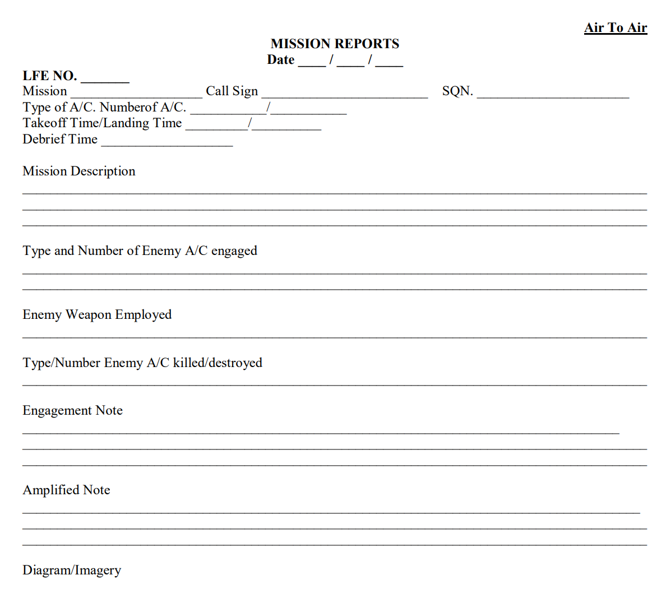
(U) Air to Air MISREP
(U) Every Mission will likely involve Air to Air engagements
(U) Be descriptive with TTPs red uses especially initial presentation, fighter regen timelines, defensive maneuvers, and shot ranges
(U) CIC needs info to update DISUMs
Notes:
(U) Hopefully, you will never have to do a debrief about a downed pilot. But, if you do, you must be sensitive to the situation. This is not a time for jokes.

Slide 20
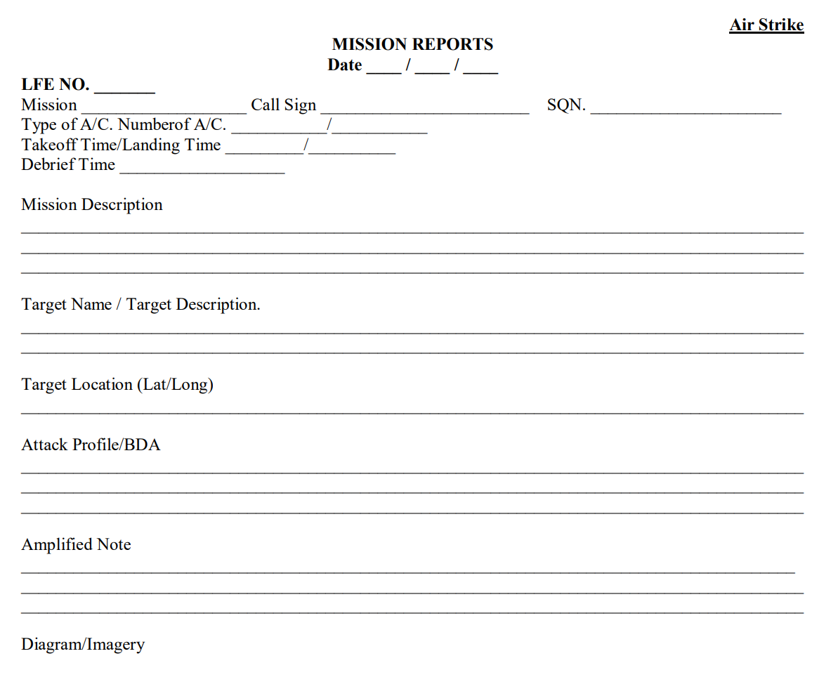
(U) Air to Ground
(U) DWE Achieved?
(U) AOC needs info to roll targets into next ATO day
Notes:
(U) Part of your debrief can be filled out well in advance using the ATO. Almost the entire Mission Data section can be filled out based on the ATO. Fill in the mission number and callsign, used for identifiers. The mission type, Vul Time, and number of aircraft should also be included.
(U) The Operations Board will give you data on the actual take off and land times. The engine shutdown time can be determined by adding 15 minutes to the land time. Some factors such as a ground emergency could prolong engine shutdown time (ESD). ESD is important since most commands have a two hour time limit for turn in of the MISREPs following ESD. This factor seems to be more important in exercises than combat scenarios. During Desert Storm, supposedly Communications tie-ups were delaying MISREPs significantly. In addition, a quality MISREP is more important than timeliness. However, if something important happened during the mission, forward that as soon as possible via STU-III or Combat Intel System. Do not delay important information. But, routine information needs to be accurate so that higher headquarters can make an accurate assessment based upon your inputs.

Slide 21
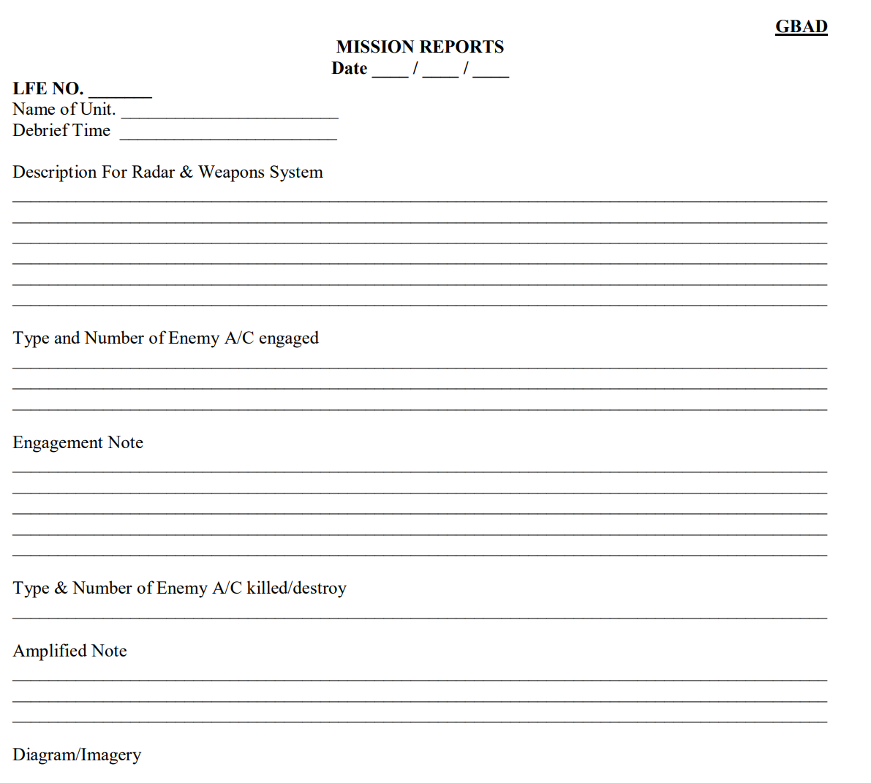
(U) Ground to Air
(U) Used for blue SAFIRE
(U) HOWEVER, blue fighters experiencing red SAFIRE should use this as a template to report SAM TTPs to CIC
Notes:
(U) Part of your debrief can be filled out well in advance using the ATO. Almost the entire Mission Data section can be filled out based on the ATO. Fill in the mission number and callsign, used for identifiers. The mission type, Vul Time, and number of aircraft should also be included.
(U) The Operations Board will give you data on the actual take off and land times. The engine shutdown time can be determined by adding 15 minutes to the land time. Some factors such as a ground emergency could prolong engine shutdown time (ESD). ESD is important since most commands have a two hour time limit for turn in of the MISREPs following ESD. This factor seems to be more important in exercises than combat scenarios. During Desert Storm, supposedly Communications tie-ups were delaying MISREPs significantly. In addition, a quality MISREP is more important than timeliness. However, if something important happened during the mission, forward that as soon as possible via STU-III or Combat Intel System. Do not delay important information. But, routine information needs to be accurate so that higher headquarters can make an accurate assessment based upon your inputs.

Slide 22
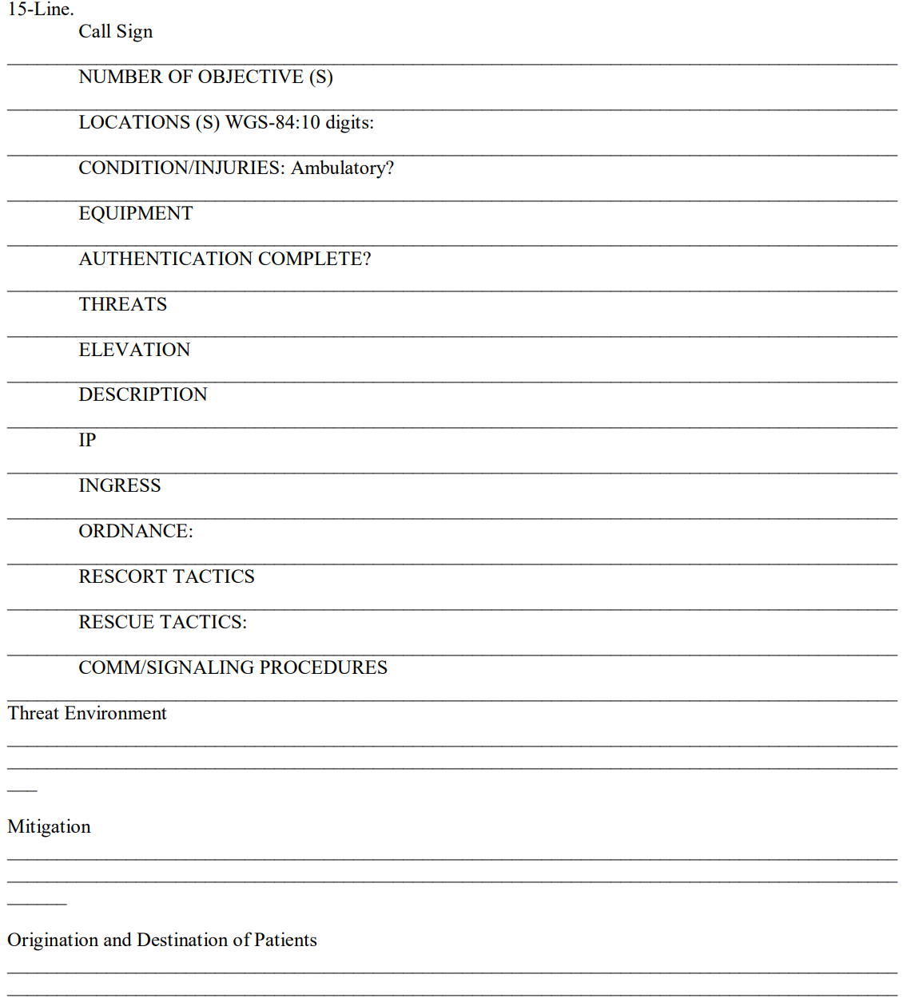
(U) CSAR
(U) AOC needs info to roll CSAR into next ATO day
Notes:
(U) Part of your debrief can be filled out well in advance using the ATO. Almost the entire Mission Data section can be filled out based on the ATO. Fill in the mission number and callsign, used for identifiers. The mission type, Vul Time, and number of aircraft should also be included.
(U) The Operations Board will give you data on the actual take off and land times. The engine shutdown time can be determined by adding 15 minutes to the land time. Some factors such as a ground emergency could prolong engine shutdown time (ESD). ESD is important since most commands have a two hour time limit for turn in of the MISREPs following ESD. This factor seems to be more important in exercises than combat scenarios. During Desert Storm, supposedly Communications tie-ups were delaying MISREPs significantly. In addition, a quality MISREP is more important than timeliness. However, if something important happened during the mission, forward that as soon as possible via STU-III or Combat Intel System. Do not delay important information. But, routine information needs to be accurate so that higher headquarters can make an accurate assessment based upon your inputs.

Slide 23
(U) TGTPOS/Target Information
(U) Prefill
  (U) Target name, target type, coordinates
  (U) Planned Time over Target (TOT) (but verify with pilots)
  (U) Munition type, #, & fuzing (type & delay)
(U) Debrief
  (U) RESULTS/...Weapons results
    (U) Unsuccessful, WHY? / Successful, how do they know?
    (U) Verify # of munitions expended
  (U) Delivery info
    (U) Time/ Location / Heading / Altitude / Airspeed / Axis / Delivery Type / Slant Range
  (U) TARWI/...Target area weather
Notes:
(U) A variety of your target information will also be available on the ATO. Normally, the only debrief items need are whether or not everyone was successful against the target. At this point, you should watch the tapes to ensure accurate description of BDA.
(U) Additionally, the TARWI codes also fall under this category. AC/USAFE/PACAF require strict adherence to USMTF regulations that state that TARWI codes will be used. However, no one writing or reading the MISREPs understand the TARWI codes. Therefore, except for exercises, the codes will probably not be used. A paranoia about inspections forces people to use processes that the otherwise would not normally use in a combat situation. However, compliance with regulations is a big fear, regardless of the applicability of the regulation to your particular situation.
(U) Again, understanding for the reader is your goal. You may decide that the best way is to simply state the weather as the pilot told you about it.
Don’t ask the pilot(s) to tell you the TARWI code itself, you must interpret that data.
(U) This is used for all missions expending air to ground ordnance (INT, CAS, SEAD, MIO, etc.)

Slide 24
(U) INFLTREP
(U) INFLTREP (In-flight Report)
  (U) Unlike other reports, this is an aircrew responsibility
  (U) Usually given during RTB
  (U) Can be used at any time for perishable info or imminent threats
(U) If it was in an INFLTREP, it should be in the MISREP
  (U) Add further information if possible

Slide 25
(U) INTREP
(U) INTREP (Intelligence Report)
  (U) Information added to a MISREP
  (U) Can be used for clarification
  (U) Can submit as many INTREPs as necessary

Slide 26
(U) ACEREP
(U) ACEREP
  (U) ATO DAY
  (U) MSN #
  (U) CALLSIGN
  (U) BE#
  (U) O-SUFF
  (U) JDPI
  (U) WEAPON (S) EMPLOYED SUCCESSFULLY (Yes/No/UNK)
  (U) TYPE OF MUNITIONS(S) EMPLOYED
  (U) DETAILS – NARR / POC

Slide 27
Questions?
This Briefing is: UNCLASSIFIED//REL TO USA, SGP, THA

