Slide 1
F-35 Capabilities
Slides: Unclassified
Capt Shaun “MOBY” Dickinson

Slide 2
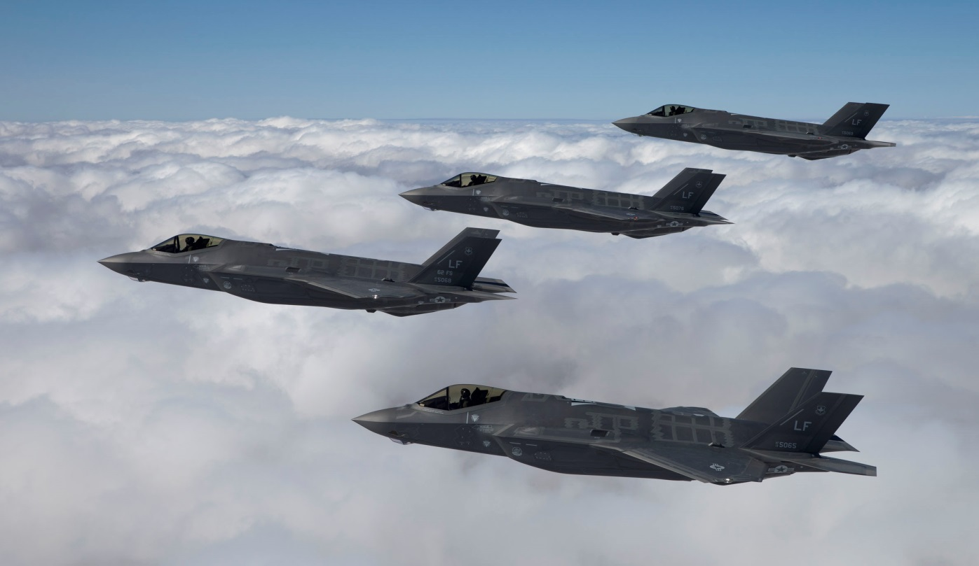
Overview
State of the F-35A
Aircraft Capabilities

Slide 3
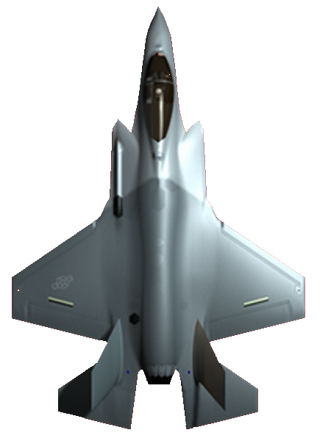
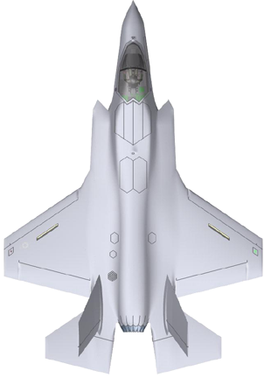
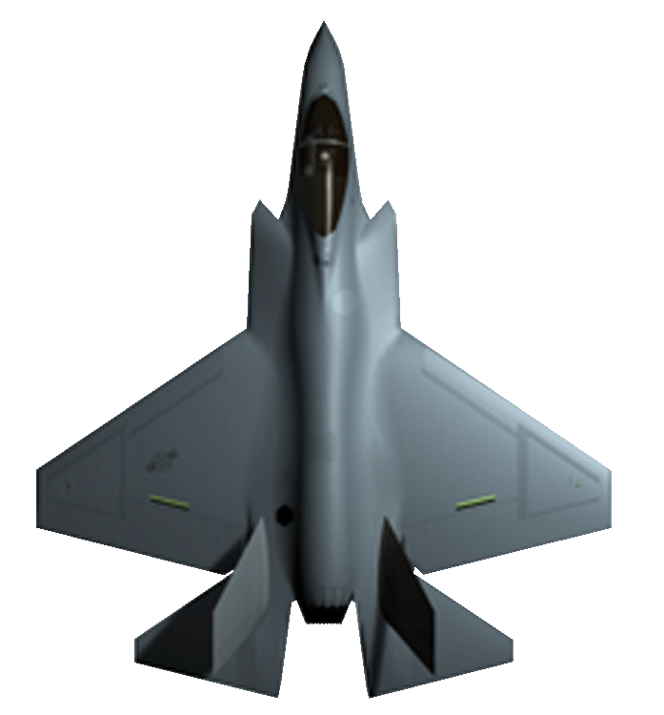
F-35 Multi-role Strike
Fighter
Goal: 80% commonality across variants
  Common airframe, hardware/software, maintenance, and training
  Future upgrades and software updates more easily incorporated
  Allows more efficient test and checkout procedures

Slide 4
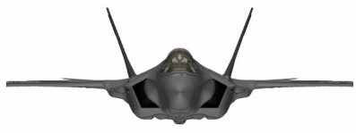
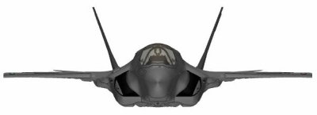
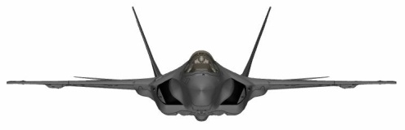
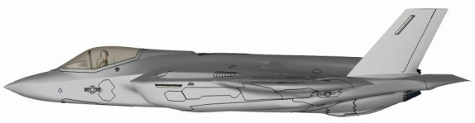
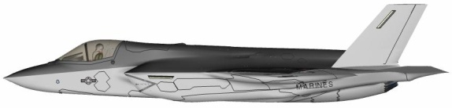
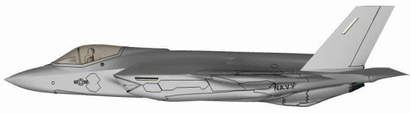
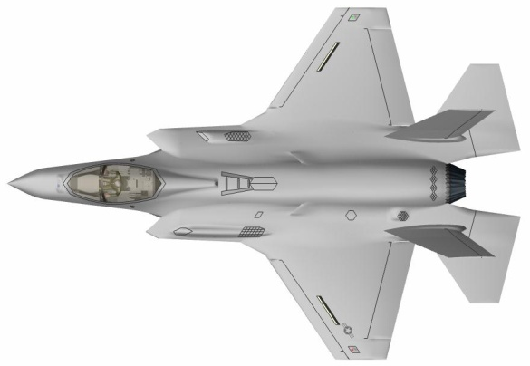
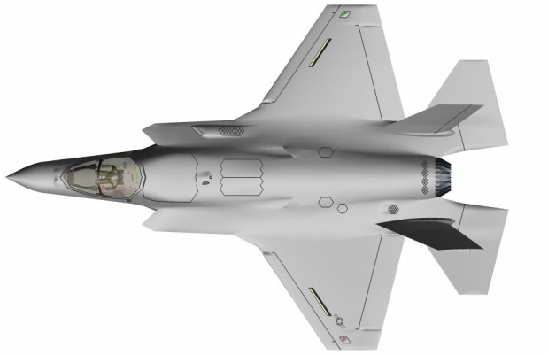
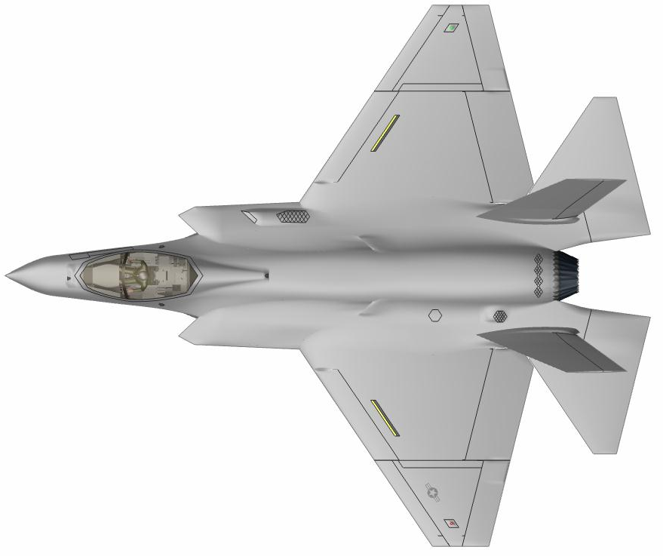
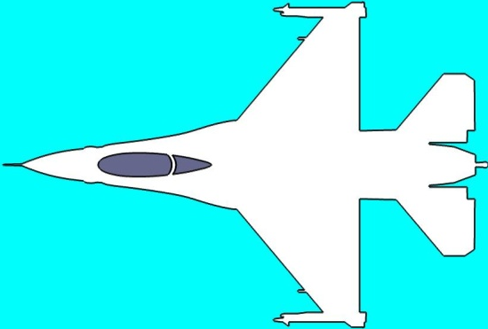


Variant Comparison
CTOL
STOVL
CV
Lift Fan Fairing
Span (ft) 35
Length (ft) 51.4
Wing Area (ft²) 460
Span (ft) 35
Length (ft) 51.1
Wing Area (ft²) 460
Span (ft) 43
Length (ft) 51.4
Wing Area (ft²) 668
Folded Span 31.1 ft
Gun Fairing
F-16
AV-8B
F/A-18C
Wing Fold
Weight Empty (lb) 29,036
Internal Fuel (lb) 18,480
Weight Empty (lb) 32,161
Internal Fuel (lb) 14,003
Weight Empty (lb) 32,072
Internal Fuel (lb) 20,085

Slide 5
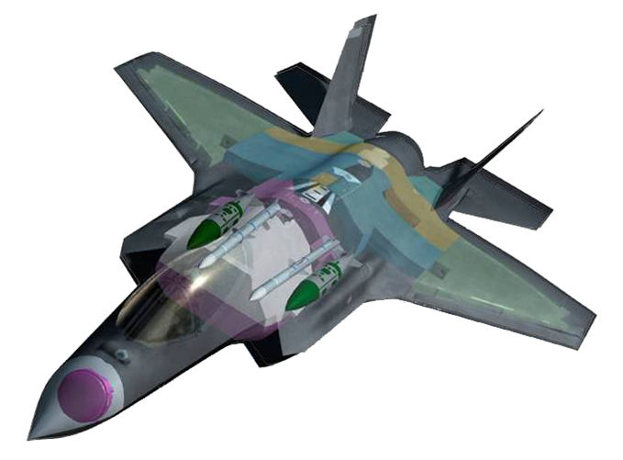
LO Design
Aircraft Shaping
Low Observable Seams
Weapons Carried Internally
Embedded Antennas
Low-Emission Radar and Avionics
DISTRIBUTION STATEMENT A: Approved for public release; distribution is unlimited

Slide 6
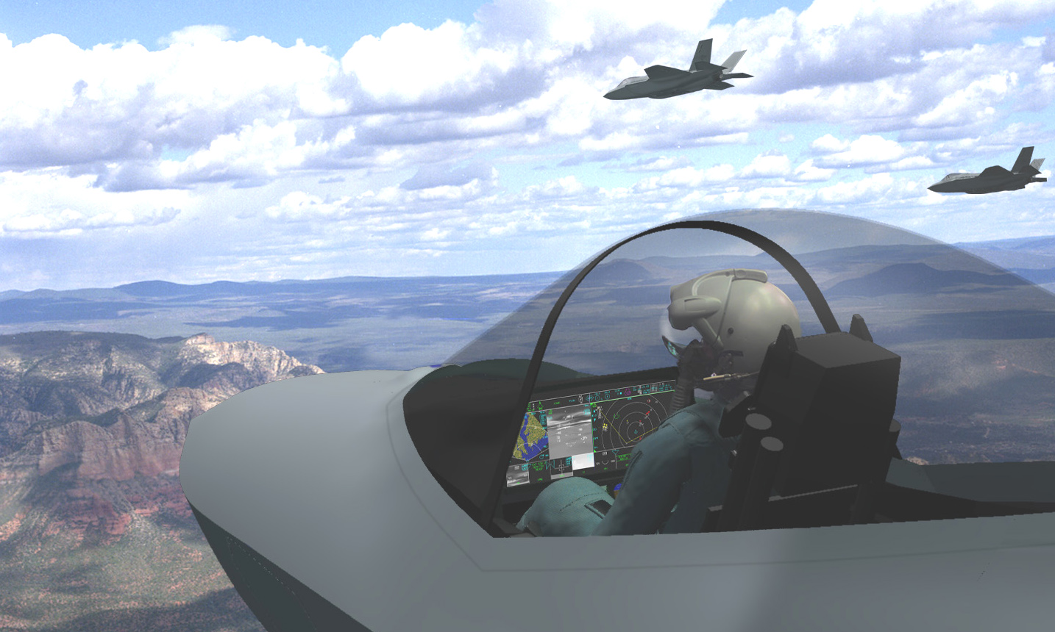
Cockpit Overview
Comparison
Next-Generation Cockpit
  20" x 8" interactive display
  Helmet-mounted display/virtual HUD
  Pilot-oriented information presentation

Slide 7
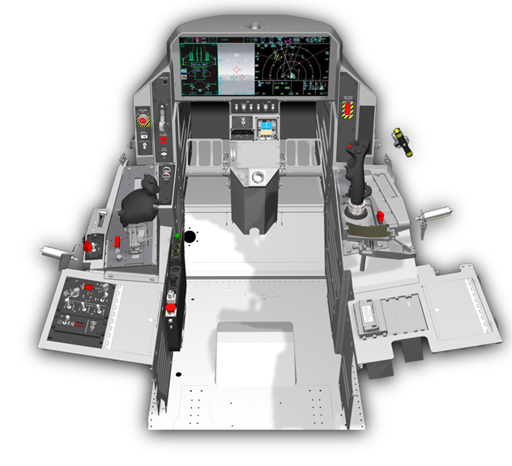
Cockpit Overview
F-35 Layout
20” x 8”
Contiguous
Display
Center
Pedestal
Left
Auxiliary Console
Right
Auxiliary
Console
Left
Console
Panel
Stick and Throttle
ICC / IPP
Panel
Services Connection Panel

Slide 8
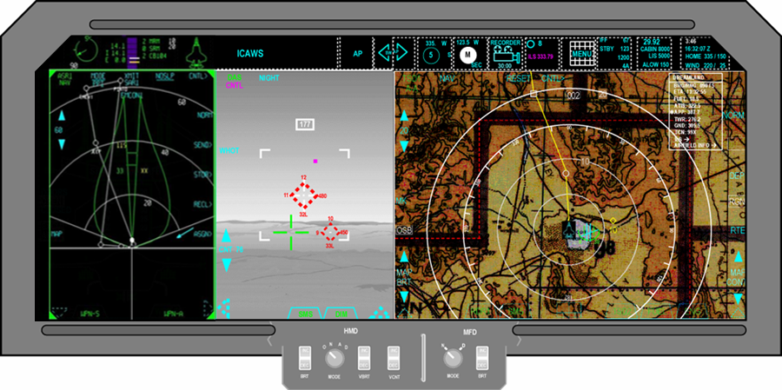




Cockpit Displays
Configurable Display Concept

Slide 9
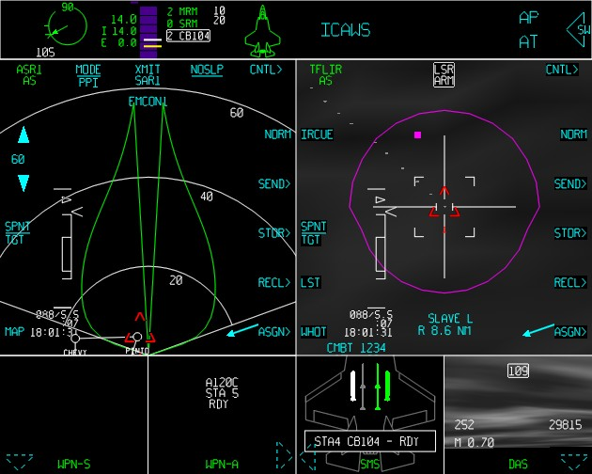
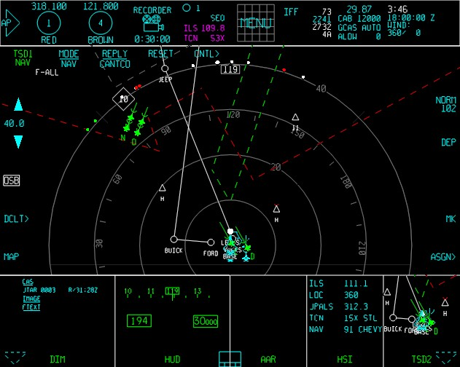
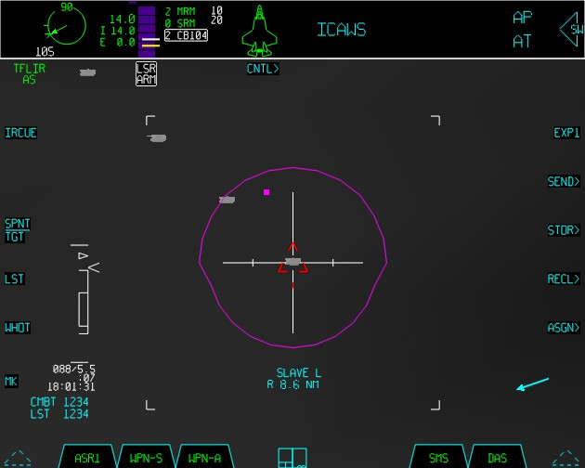
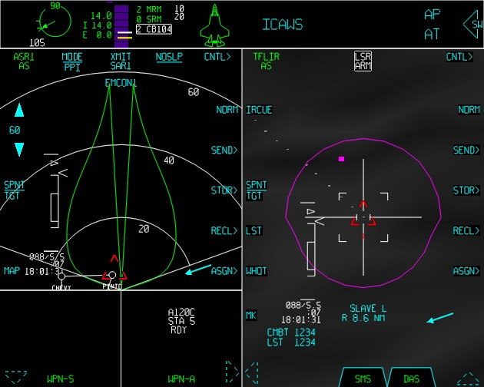
Cockpit Displays
Configurable Display Concept
Portal control
Pilot configurable
Master Modes

Slide 10
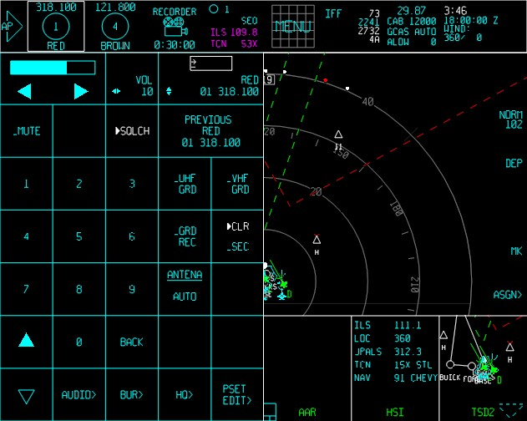
Cockpit Displays
Virtual Data Entry Device (vDED)

Slide 11
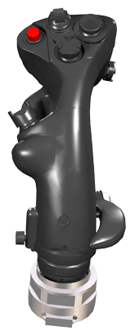
Sidestick
Target Management Switch (TMS)
Trim Switch
Weapons Release Enable (Pickle) Switch
Zoom/Expand FOV
Display Management Switch (DMS)
Electronic Warfare Switch (EWS)
Adjustable Hand Rest
Sidestick
(View From Back)

Slide 12
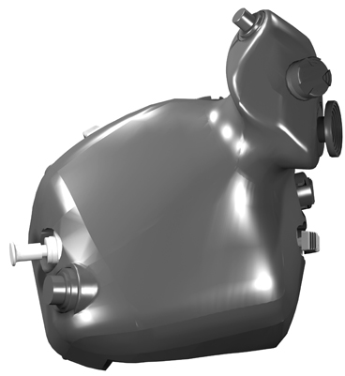
Throttle Grip
Weapon Management
Switch (WMS)
Cage/Uncage
Cursor Slew
Controller
External Lights
Speed Brake
MPO
Flare
Throttle Grip
(View From Top)

Slide 13
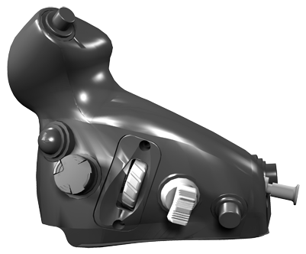
Throttle Grip
Cage/Ungage
APC
Speed Hold
Communication Control
& Voice Recognition (VR)
Polarity Control
External Lights
Management Switch
Throttle Grip
(View From Front)

Slide 14
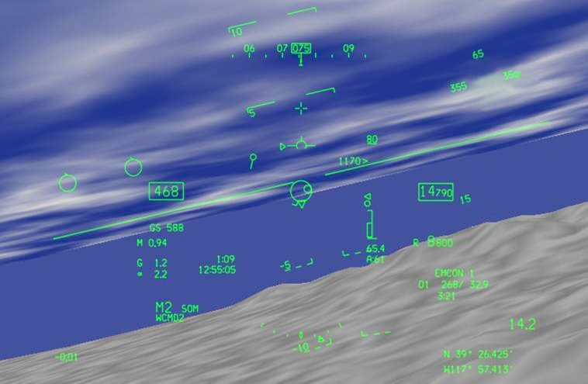
Helmet Mounted Display (HMD)
Symbology
Friendly Air
Symbology
Air-to-Air
Symbology
18L
Air-to-Surface
Symbology

Slide 15
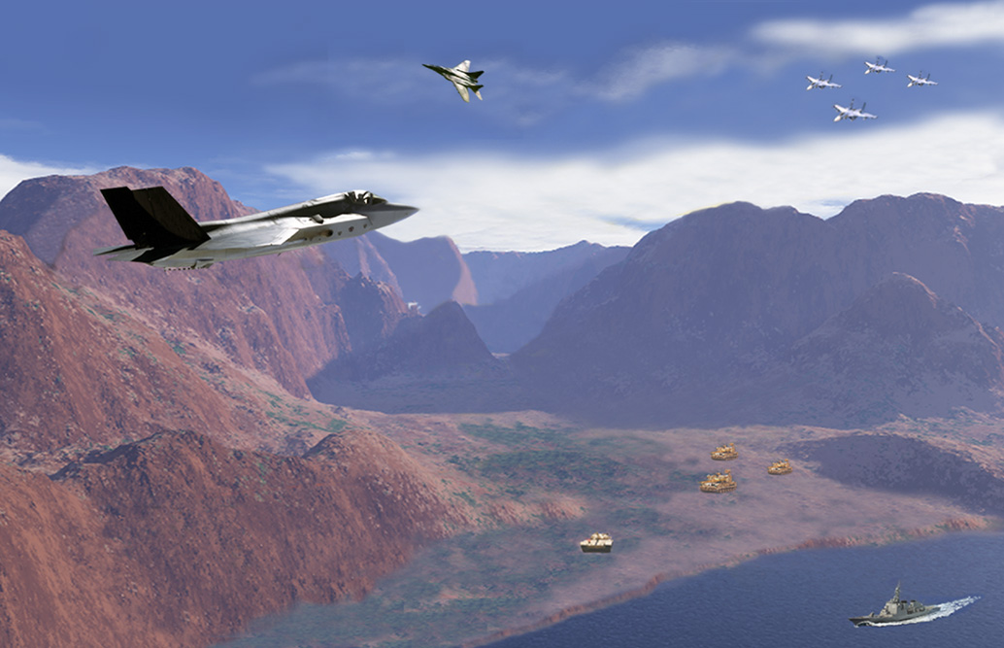


APG-81 Radar Advanced Electronically Scanned Array
Air-to-Air Target Engagement
Air-to-Air Target Detection/Track
Synthetic Aperture RADAR
Electronic Attack/
High Gain ESM
Ground Moving Target Detection
Sea Surface
Detection
Lockheed Martin Aeronautics Company
DISTRIBUTION STATEMENT A. Approved for public release; distribution is unlimited.
JSF Approved General Briefing Oct 2003 - 15

Slide 16
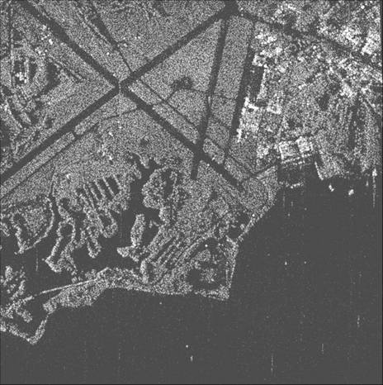
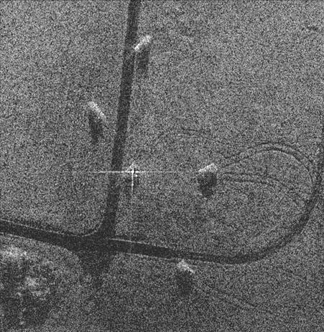
SAR Maps
Legacy Resolution
JSF APG-81 Resolution
DISTRIBUTION STATEMENT A: Approved for public release; distribution is unlimited

Slide 17
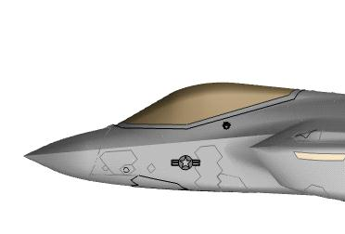

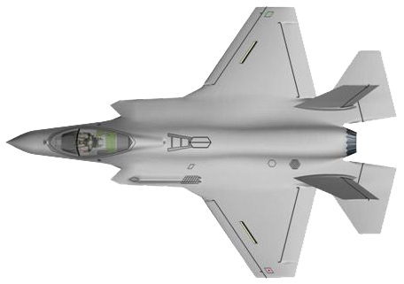
Integrated Avionics Suite
Full Spherical Coverage by Distributed Aperture System
RWR
360 Deg Coverage
EO
Targeting
System
Band 3/4
Radar
Warning
Fwd Band 3/4
Fwd Band 2
RADAR
Array &
Electronics
_{DAS Apertures}
RADAR
Aft Band 2
ESM
Fwd Band 2
Band 3/4
Radar
Warning
Fwd Band 3/4
Emitter Locating
SATCOM
Data Links

Slide 18
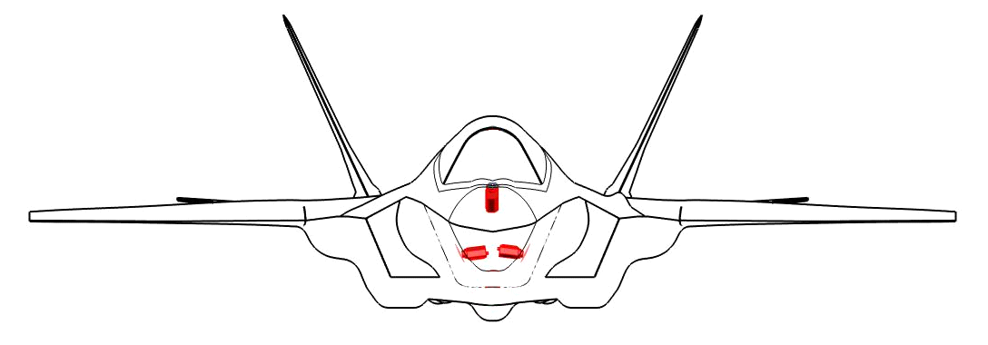
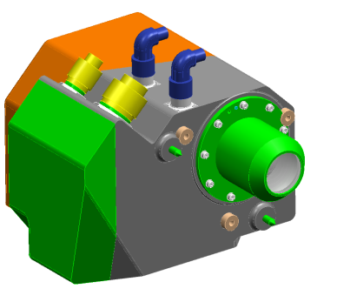
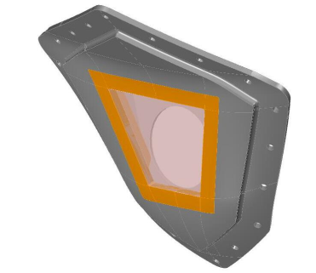
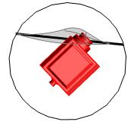
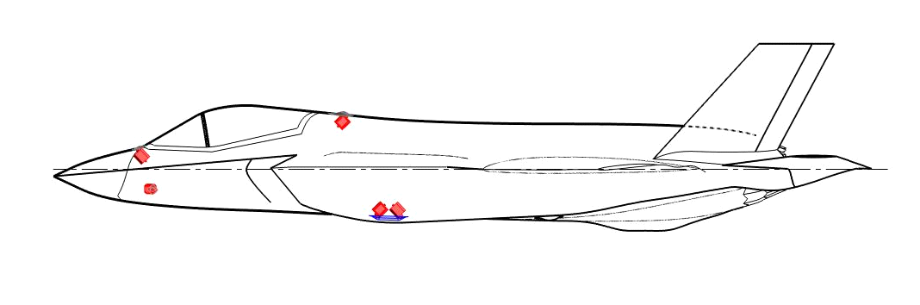
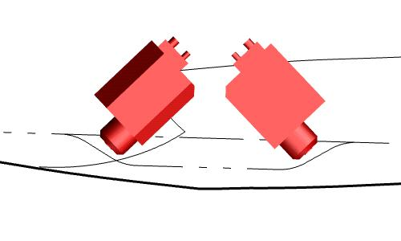
Distributed Aperture System (DAS)
Sensor Array
3
1
2
Upper
Forward
4
Upper Aft
Left Side
Lower
Forward
5
6
Lower Aft

Slide 19
Distributed Aperture System
Internally Mounted
Missile Launch Detection
Threat Aircraft Detection
Track Wingman
NAVFLIR Functions
Integrated With HMD
Notes:
Replaces Night Vision Devices
Sees everything worlds best RIO

Slide 20
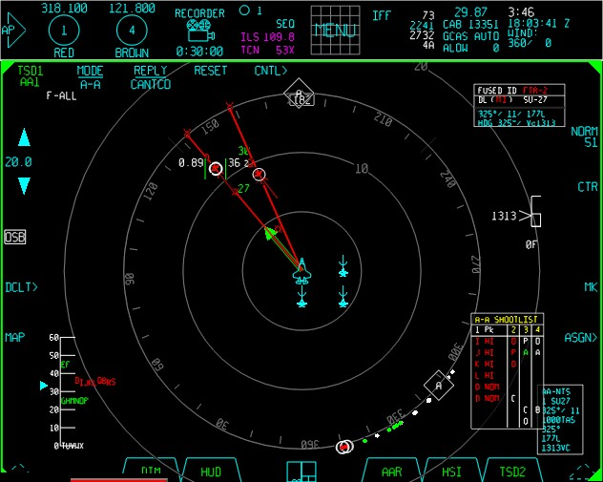
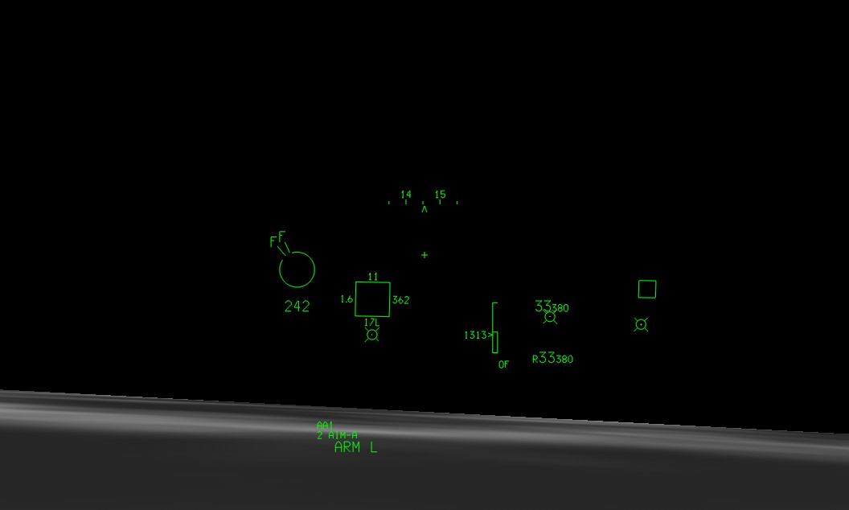
Capabilities
DAS Missile Warning Symbology

Slide 21
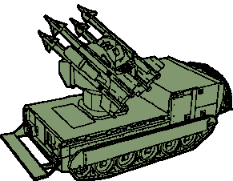

Electro-Optical Targeting System (EOTS) Capabilities
Air-to-Air Targeting FLIR
Long Range A-A IRST
Laser
Designation
Air-to-Surface
Targeting FLIR
Laser Spot Tracker
Lockheed Martin Aeronautics Company
DISTRIBUTION STATEMENT A. Approved for public release; distribution is unlimited.
JSF Approved General Briefing Oct 2003 - 21

Slide 22
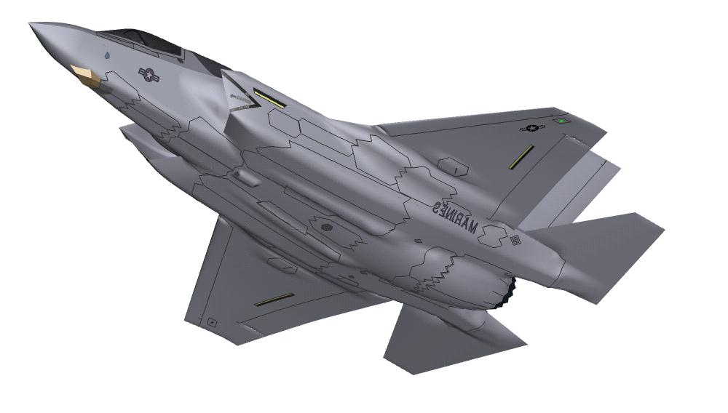
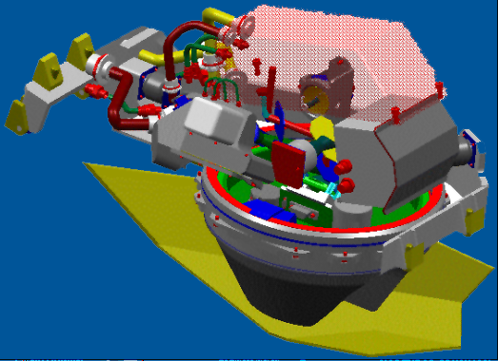
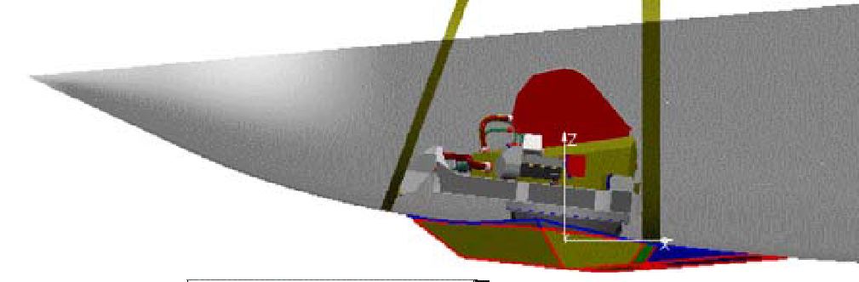
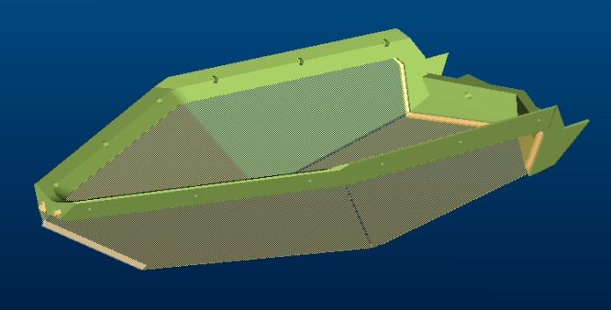
Electro-Optical Targeting System (EOTS) Sensor Location
Sensor/Window
Installation
Seven Sapphire
Faceted Window
Configuration
EOTS
110º
Notes:
Sniper 3.0
Block 4 upcoming,

Slide 23
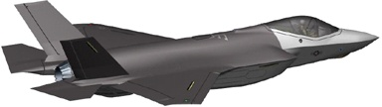
Communication, Navigation, ID (CNI)
Capabilities
Voice Communications
VHF Lo-FM (30-88 MHz)
VHF AM (108-156 MHz)
VHF Hi-FM (136-174 MHz)
UHF AM (225-400 MHz)
UHF FM (225-400 MHz)
Havequick
SINCGARS
GUARD Monitor (243/121.5)
KY-58 Secure Voice
Data Message Formats
TADIL-J
JVMF / VMF (K-series)
TADIL-C (partial)
OTCIXS-II
OTH-Gold
TACFIRE
AFAPD
Data Communications
Link 16
Link 16 Enhanced Throughput
MADL (JSF Wideband)
Weapon Data Link (AWW-13)
Navigation/Landing Aids
INS
GPS
Radar Altimeter
ILS Marker Beacon
ILS Glideslope
ILS Localizer
TACAN
Carrier ILS
MLS (w/DME-P)
JPALS*
Audio Functions
Voice Messaging
Voice Recognition (Support)
Air Refuel Intercom (CTOL)
Maintenance Intercom
Active Noise Reduction
Identification/Surveillance
Mark XII Transponder
Mark XII Interrogator

Slide 24
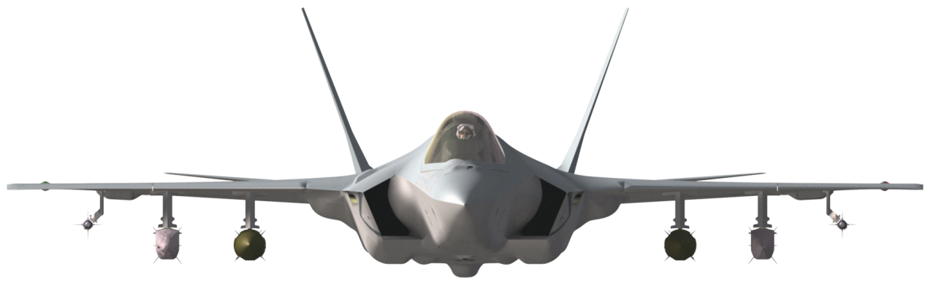
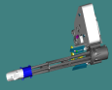
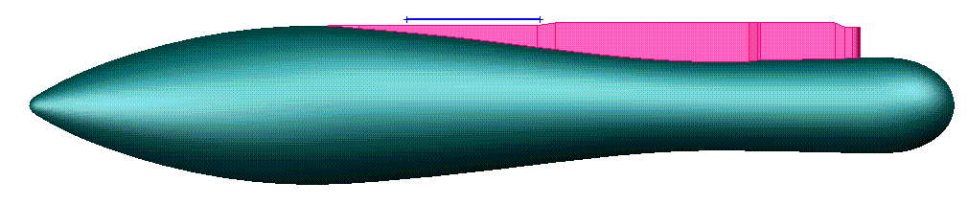




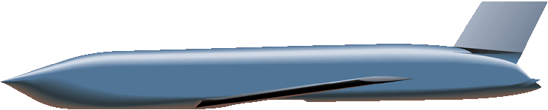












CTOL Weapons Carriage Requirements
CTOL Internal Gun
Store Fully Certified During SDD
EXTERNAL WEAPONS
INTERNAL
EXTERNAL WEAPONS
426 -Gallon Wing Tank
GBU-32 JDAM 1,000-lb
(MK-83/BLU-110 Warhead)
GBU-10 Paveway II 2,000-lb LGB (MK-84 Warhead)
Stormshadow
GBU-12 Paveway II 500-lb LGB
(MK-82 Warhead)
GBU-24A/B Paveway III 2,000-lb LGB (MK-84 / BLU-109 Warhead)
GBU-38 JDAM 500-lb
(MK-82 Warhead)
GBU-31 JDAM 2,000-lb
(MK-84 Warhead)
GBU-16 Paveway II 1,000-lb LGB (MK-83 Warhead)
AGM-158 JASSM
MXU-648/CNU-88 Baggage Pod
MK-83 BLU-110 LDGP 1,000-lb LDGP
AGM-154A/C JSOW Glide Bomb
AGM-154A/C JSOW Glide Bomb
MK-83 BSU-85 HDGP
CBU-103/105 WCMD
GBU-38 JDAM 500-lb
(MK-82 Warhead)
AIM-120B/C AMRAAM
MK-84 2,000-lb LD/HDGP
GBU-31 JDAM 2,000-lb
(MK-84 Warhead)
Brimstone/Joint
Common Missile
GBU-31 JDAM 2,000-lb
(BLU-109 Warhead)
MK-84 BSU-50 Ballute 2,000-lb HDGP
AIM-9X Sidewinder
GBU-32 JDAM 1,000-lb
(MK-83/BLU-110 Warhead)
BDU-57/58/60
Laser-Guided Training Round
AIM-120C AMRAAM
AIM-132 ASRAAM
GBU-12 Paveway II 500-lb LGB
(MK-82 Warhead)
Weapons Currently Under Development
GBU-31 JDAM 2,000-lb
(BLU-109 Warhead)
MK-82 500-lb LD & HD
UK 500# PGB
Phase I SDB
CBU-99/100 Rockeye II
Cluster Munition
CBU-103/105 WCMD
Brimstone/Joint
Common Missile
Missionized Gun
MK-76/MK-58/BDU-48
DISTRIBUTION STATEMENT A. Approved for public release; distribution is unlimited.
AIM-132 ASRAAM
Notes:
External Weapons
Change 480 gallon wing tank to 426 gallon wing tank
Add AIM-120B AMRAAM
Update Missionized Gun image
Make font color change to denote only MK-82 500lb LD is certified in SDD
Internal/External Weapons
Removed ΧΒΥ−87/89/97 Χλυστερ Μυνιτιονσ
Ρεμοϖεδ ϑΔΑΜ ΠΙΠ

Slide 25

Weapons Bays
Airframe Orientation
Internal Weapons Bays

Slide 26



Components Doors
CTOL and CV variants share same bay and can carry 2000 lb weapons
STOVL has a smaller bay and is limited to 1000 lb class weapons
CTOL
STOVL

Slide 27


Components Doors
Two operational modes
  Ground = 10-15 seconds open/close
  Inflight = 2.4 seconds open/close
Ground Operations
In Flight Operations
27
Notes:
<insert time>

Slide 28

Weapons Stations
Station Designation & Specifications
8
7
5
4
4 internal weapons stations (similar on all variants)
  Stations 4 & 8 (outboard, internal) can carry either air-to-surface stores or air-to-air missiles
  Stations 5 & 7 (inboard, internal) can carry air-to-air missiles

Slide 29
Weapons Stations
Station Designation & Specifications
11
10
9
3
2
1
6
Seven external weapons stations (similar on all variants)
  Stations 3 and 9 carry 5000-lb stores or fuel
  Stations 2 and 10 carry 1000-lb stores
  Centerline station (6) can carry missionized gun only
  Remaining 2 stations (1 and 11) can carry AIM-9X or AIM-132 ASRAAM missiles

Slide 30

Gun System
Components & Operation
Internal Gun
  181-round Ammunition Handling System (AHS)
Ammunition
Container
(181 rounds)
25mm
4,000 RPM

Slide 31
OCA/DCA
SCL
  DCA 4 x AIM-120
  Future Sidekick 6 x AIM-120
  OCA 2 x AIM-120, 1 x GBU-31, 4 x GBU-39
Playtime
  35.6 to 60 mins

Slide 32

Questions?
?

